Slide 1

Multiple Linear Regression
Part 1: An Introduction
Notes:
This is the first of a series of short videos that will introduce you to the statistical modelling approach called linear regression. In this video, we will learn how relationships between two variables can be approximated by a line.

Slide 2


Multiple Linear Regression
Part 1: An Introduction
Notes:
Without realising it, you probably perform a sort of multiple linear regression every day. When you wake up, one of the first things you might do is have a look out the window. You want to see what kind of day it is going to be, based on whether the sky is clear or grey.

Slide 3
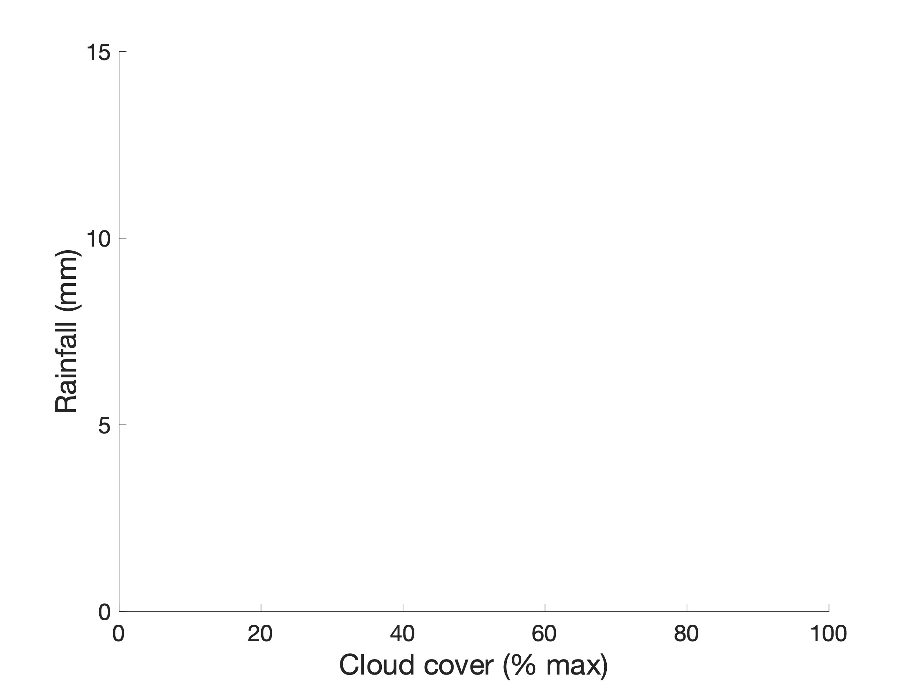

Day 3
Day 2
Day 1
Notes:
By doing this every day, you are collecting observations about the relationship between the greyness of the sky and the chance that it will rain. In way, you are performing a linear regression here.

Slide 4
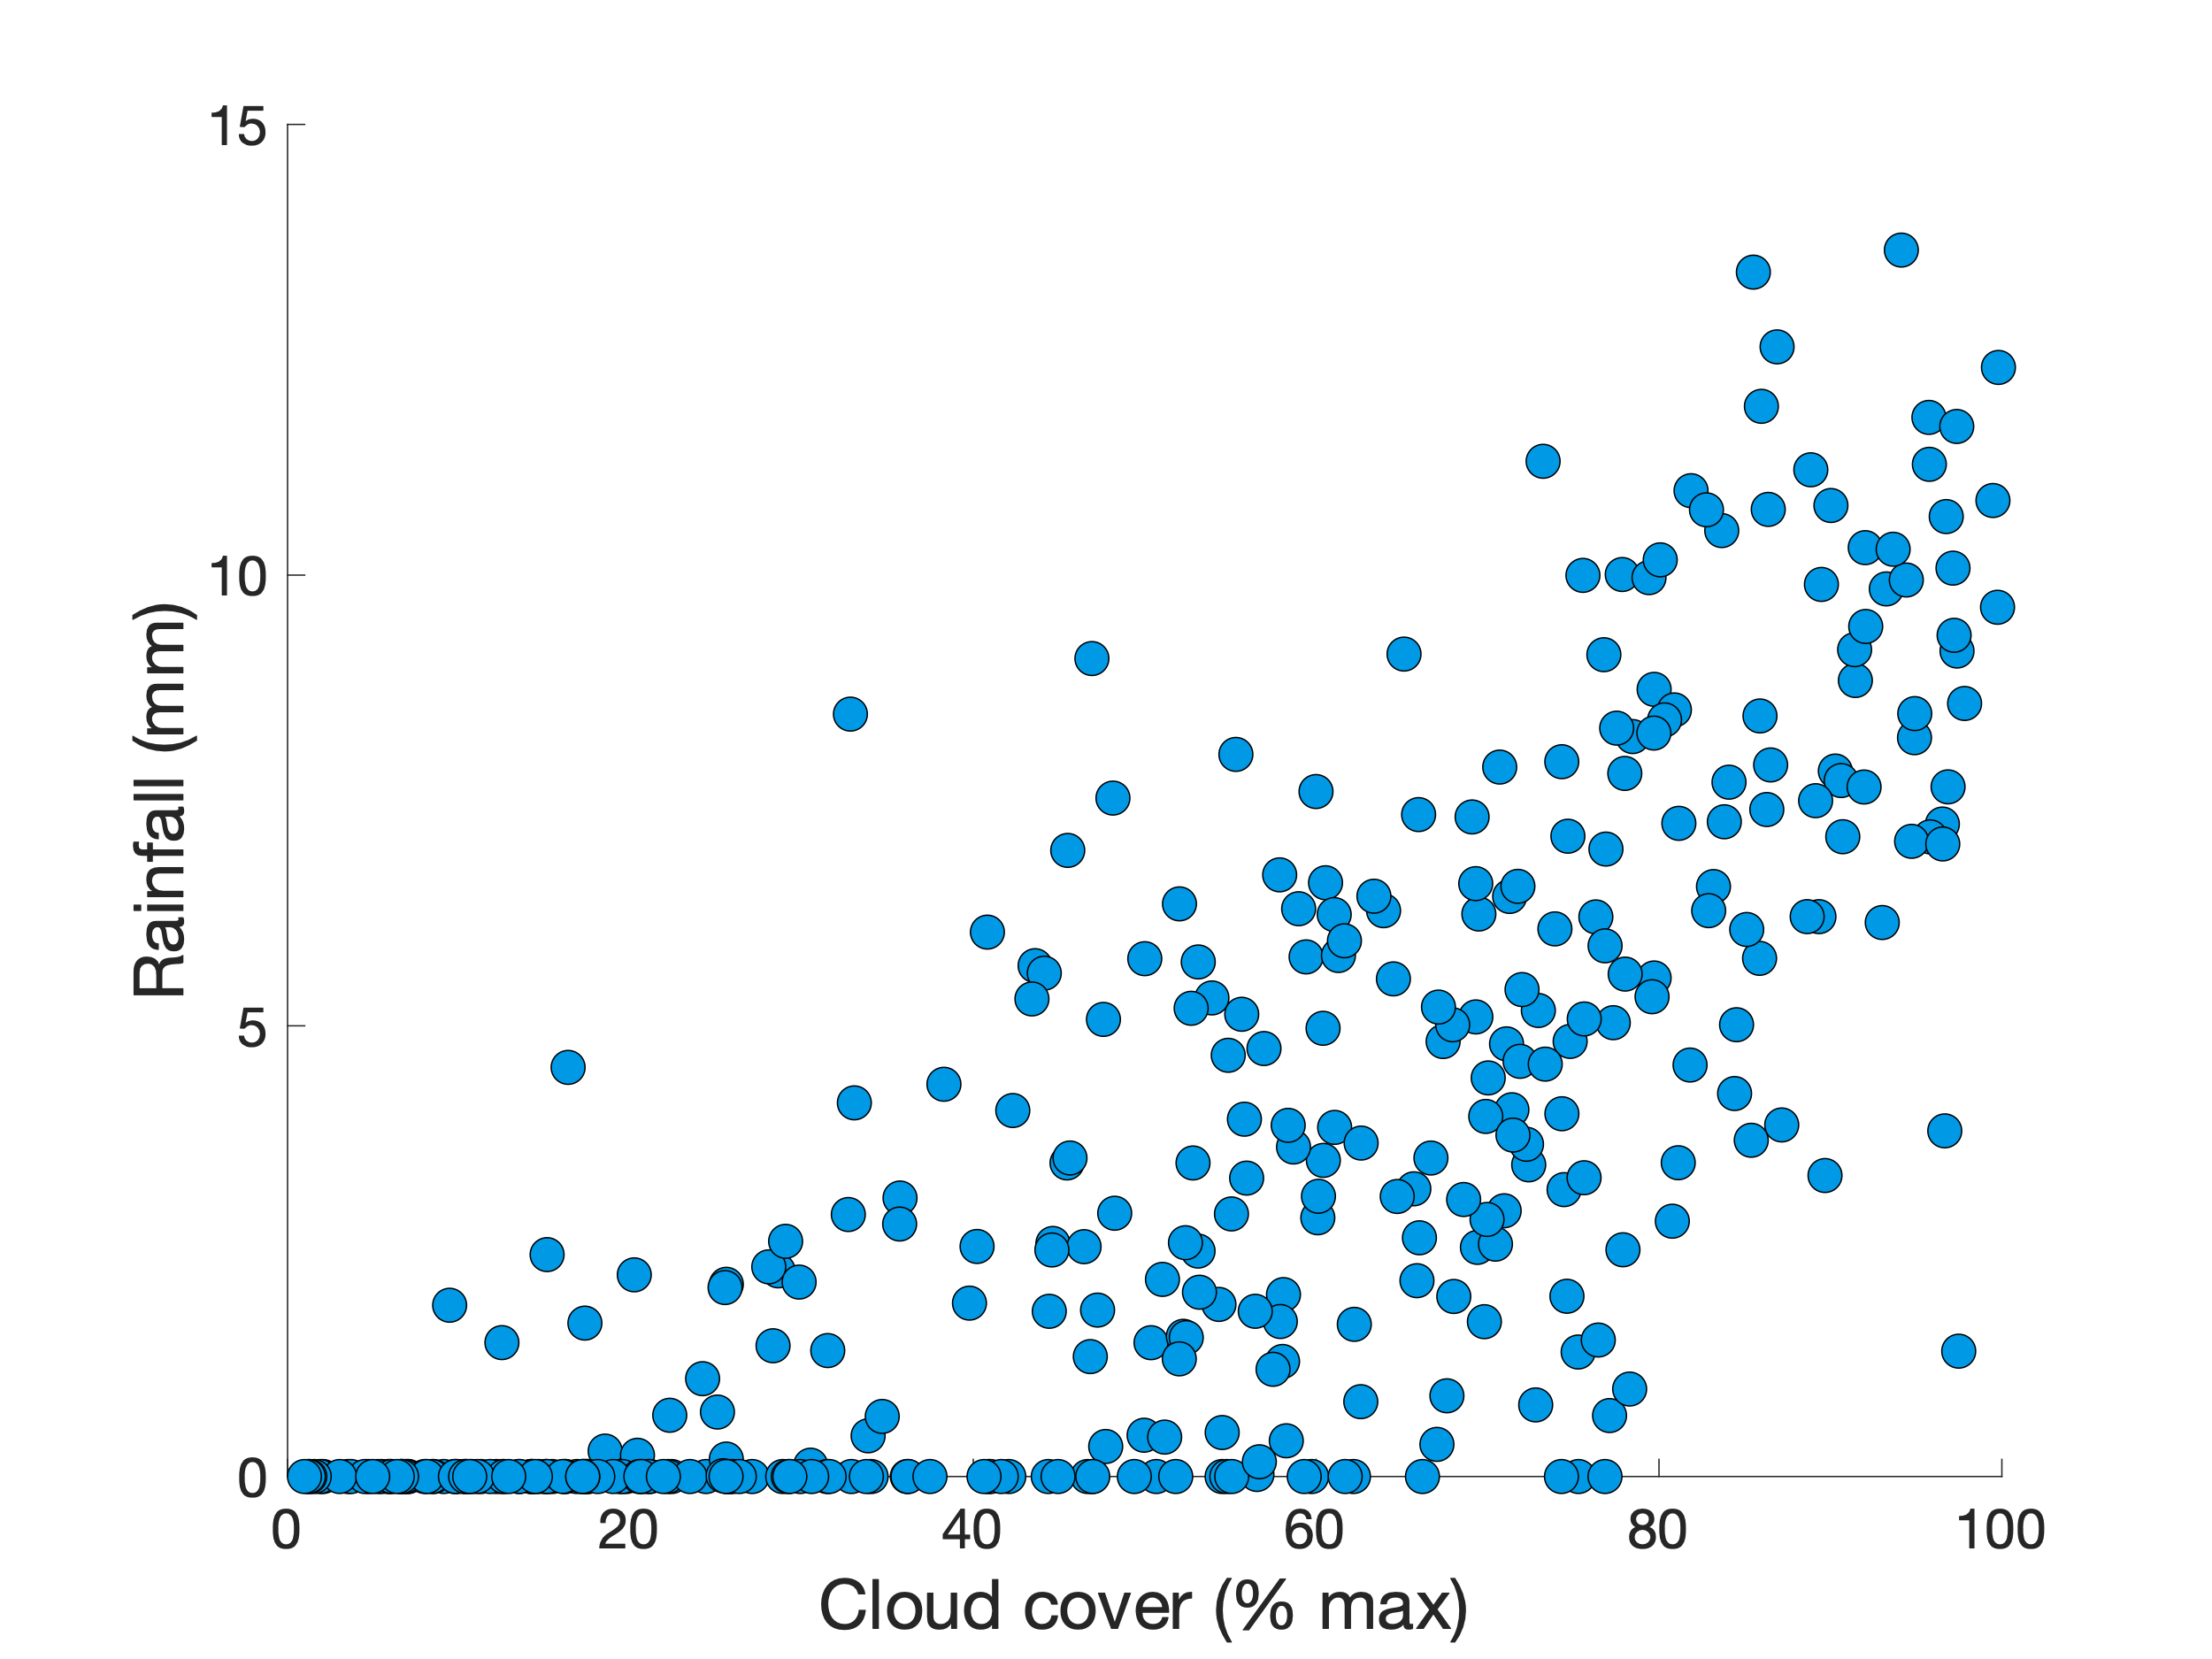

Notes:
Your brain is building a scatterplot, like this one, showing that, the greyer the sky, the more handy an umbrella will be.

Slide 5
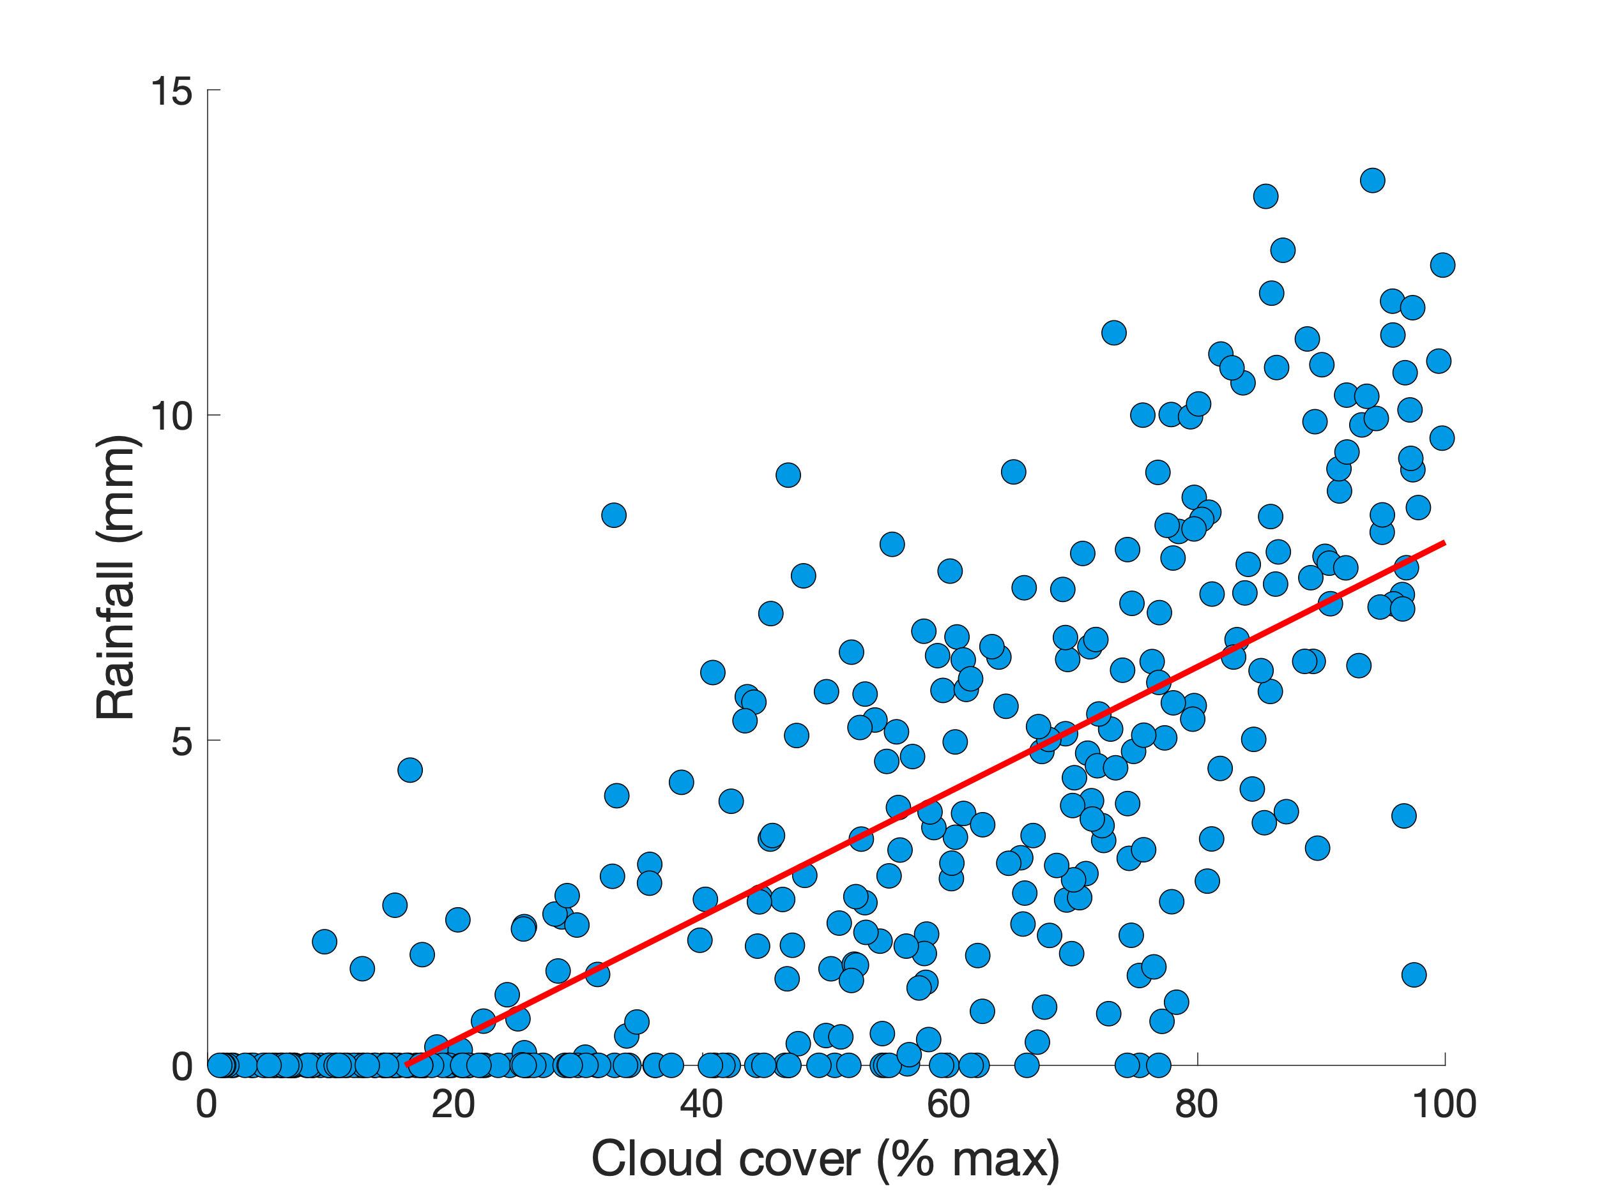

Notes:
If we draw a line to approximate these dots, we are making a so-called “linear model” of the relationship between cloud cover and rainfall.

Slide 6
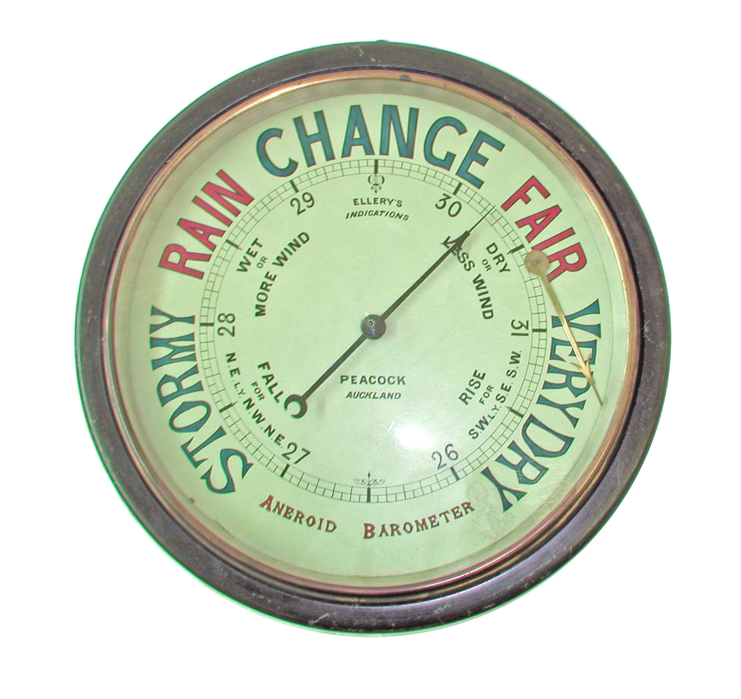

Notes:
Now, if you wanted to be a bit more scientific about this, you could buy yourself a barometer. Barometers can be used to measure changes in atmospheric pressure, and give an even better prediction of rainfall. A low barometric pressure indicates it is more likely to rain.

Slide 7
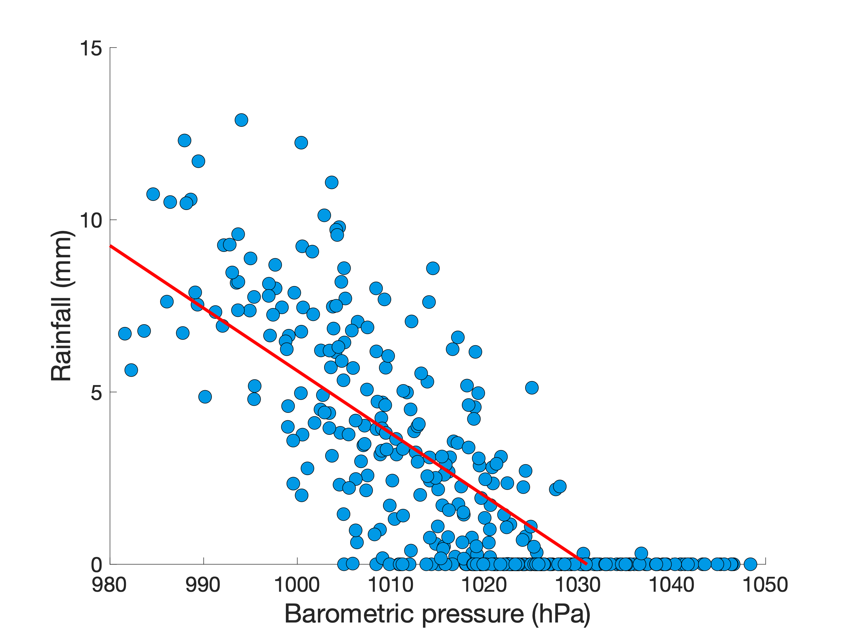
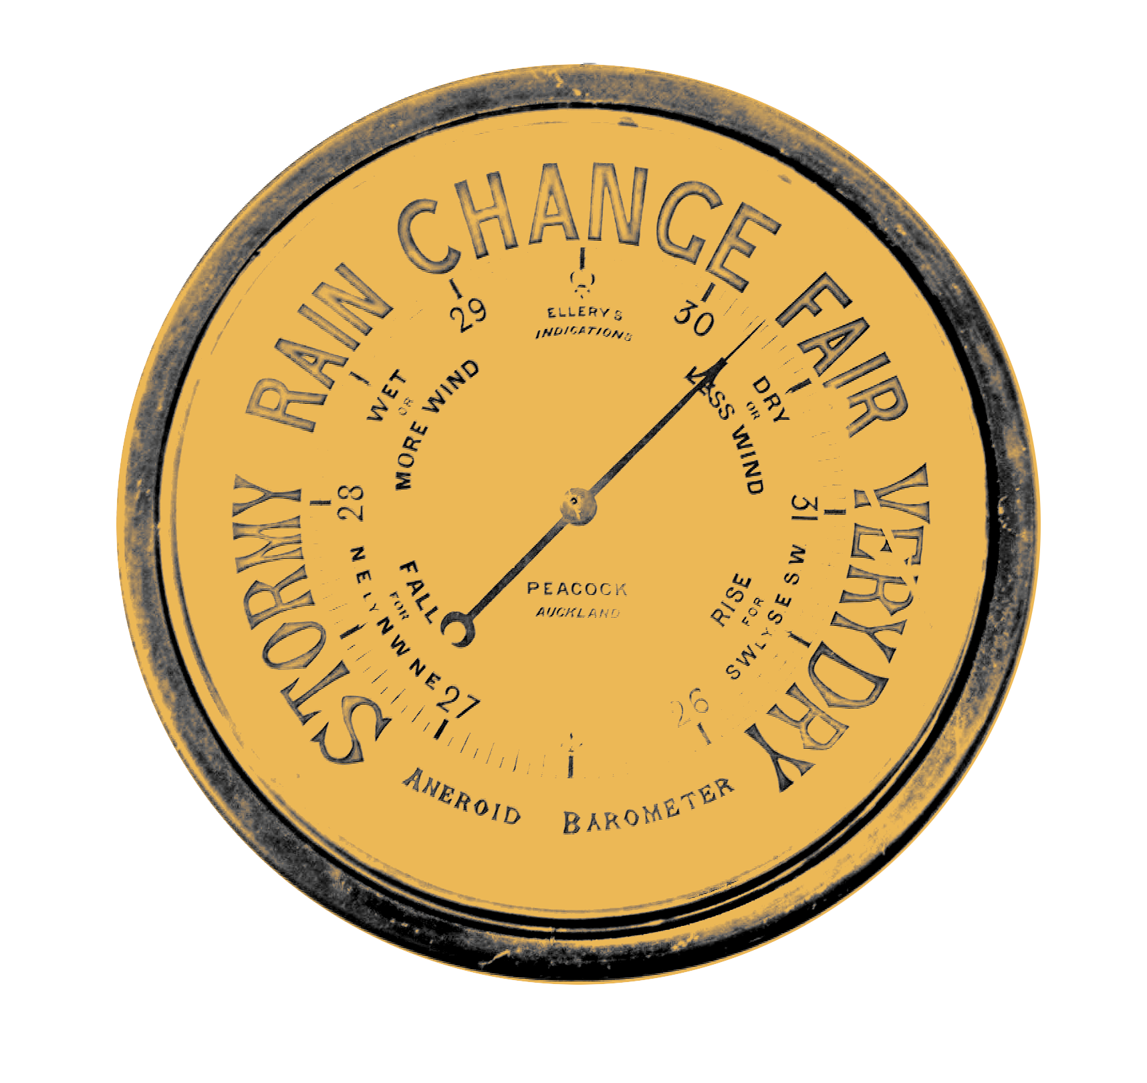

Notes:
As for your cloud cover observations, you can take your barometer readings and build a scatterplot. Here, we see that relationship slopes downwards.

Slide 8

Positive association
Negative association
Notes:
Say that every day you wake up, you record how grey the sky is, along with your barometer reading. At the end of the day, you record how much rain fell during the day. After 365 days, you would be able to construct scatterplots like these. Notice that these two plots slope in opposite directions; rainfall increases as cloud cover increases, but it decreases as barometric pressure increases. These are called “positive” and “negative associations”, respectively.

Slide 9

Coming up...
How do we specify a line to fit our data points?
Notes:
In our next video, we’ll explain how linear models are expressed mathematically, and how we can find out the best linear parameters to fit our observations

