Slide 1
Multiple Linear Regression
Part 2: The line equation
Notes:
In this video, we will look a bit closer at the line equation, which is the basis for linear regression modelling. We will use this equation to find the line that best approximates the relationship between our two variables.

Slide 2
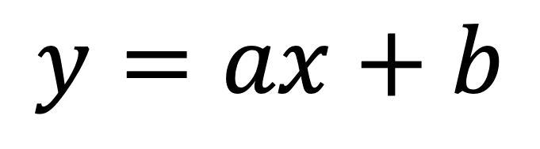
Equation of a line
$$y=ax+b$$
Notes:
This is the simple equation of a line in 2D space.

Slide 3
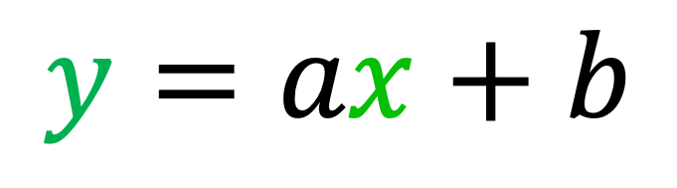
Equation of a line
$$y=ax+b$$
Variables
Notes:
It is comprised of two variables, typically called X and Y

Slide 4
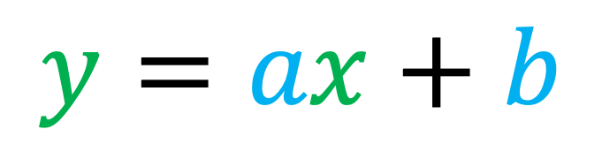
Equation of a line
Parameters
$$y=ax+b$$
Variables
Notes:
And two parameters, which determine the slope (A) and the Y-intercept (B) of the line

Slide 5
Equation of a line
Parameters
$$y=ax+b$$
Variables

Slide 6
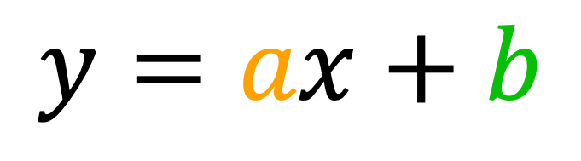
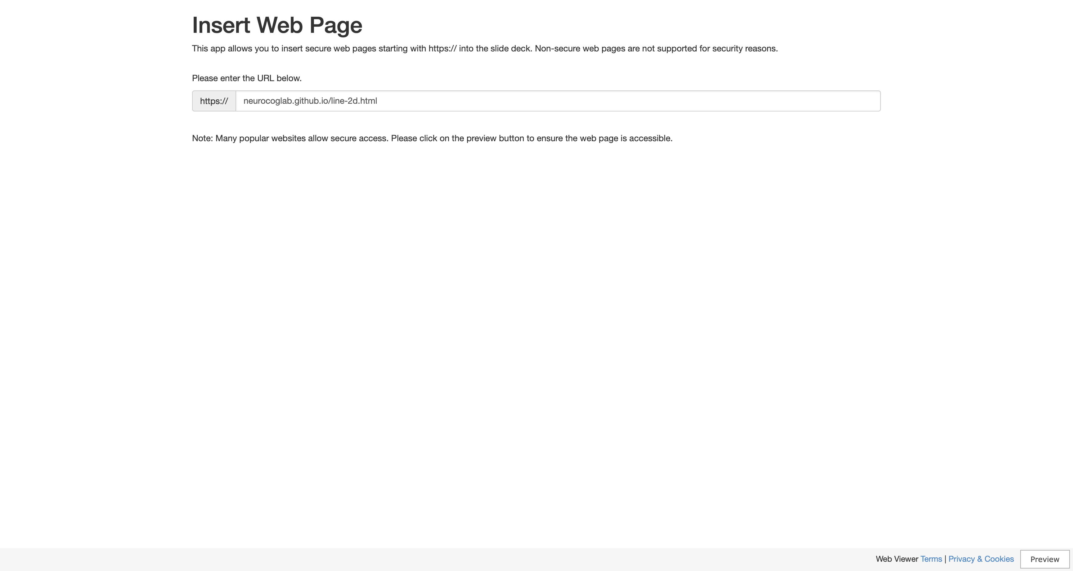
Equation of a line
$$y=ax+b$$
Notes:
This interactive plot allows us to explore how the A and B parameters influence the position and slope of the line.
In particular, positive slopes increase from left to right, while negative slopes decrease. You can experiment with this plot yourself later in this module.

Slide 7
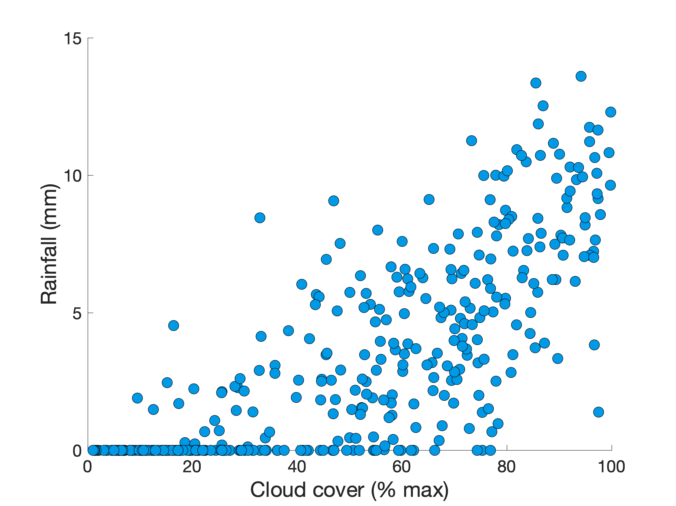
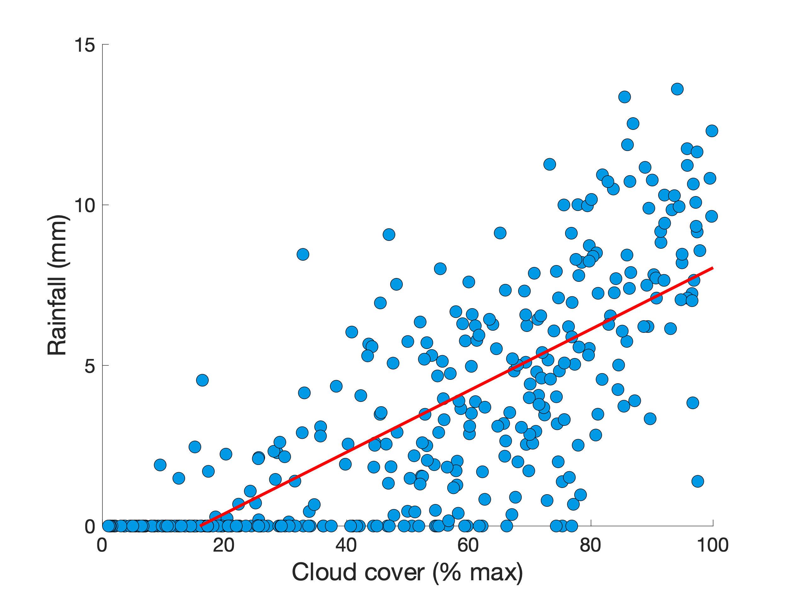







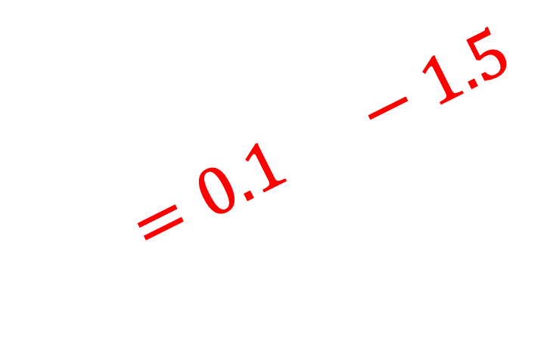
$$y=ax+b$$
$$=0.1 −1.5$$
$$y$$
$$x$$
Notes:
Let’s go back to our rainfall example.
It’s important to understand that X and Y are simply symbols for any variables we are interested in investigating.
For this example, X represents cloud cover (as a percentage of maximum), and Y represents rainfall (in mm).
We could just as easily use icons to symbolise these relationships.
The line we’ve fit to our rainfall data is explained by two parameters:
* A slope of 0.1 (meaning an increase in 0.1 mm of rainfall for every percentage increase in cloud cover)
* An intercept of -1.5, which determines the vertical position of the line (in the center of the data points)

Slide 8
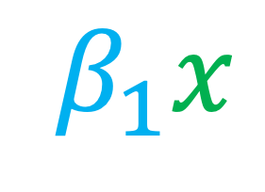




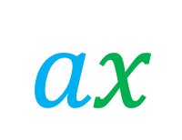
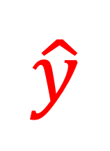
The linear model
$$y=$$
$$ax$$
$$β_{0}$$
$$+$$
$$β_{1}x$$
$$\hat{y}$$
$$b$$
“the predicted value of y”
Notes:
When we talk about linear models in statistics, the variables and parameters have slightly different symbols – but this does not change the equation!
Usually, the two terms are switched such that the intercept comes first.
The A and B parameters become beta 1 and beta 0, respectively. This becomes more useful later, when we scale things up to more than one X variable!
Finally, when we refer to a model that is attempting to predict the Y variable from the X one, we put a hat on the Y, like so.
It’ worth noting here that our Y variable is called the outcome or criterion variable, and our X is called the predictor variable.

Slide 9
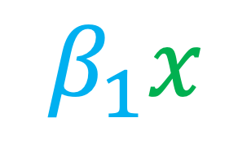



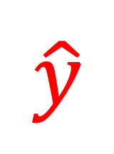
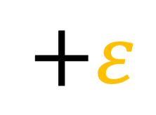
The linear model
“the observed value of y”
“model error”
$$y=$$
$$ax$$
$$β_{0}$$
$$+$$
$$β_{1}x$$
$$b$$
$$+ε$$
$$y=$$
$$ax$$
$$β_{0}$$
$$+$$
$$β_{1}x$$
$$\hat{y}$$
$$b$$
$$\hat{y}$$
“the predicted value of y”
Notes:
The linear model can also be expressed with respect to the observed values, Y (without its little hat).
In this case, we represent the variation of data points from the predicted values as the model error, or epsilon.
Another way to write this is that the observed (hatless) Y values are the sum of the predicted values and the model error.

Slide 10
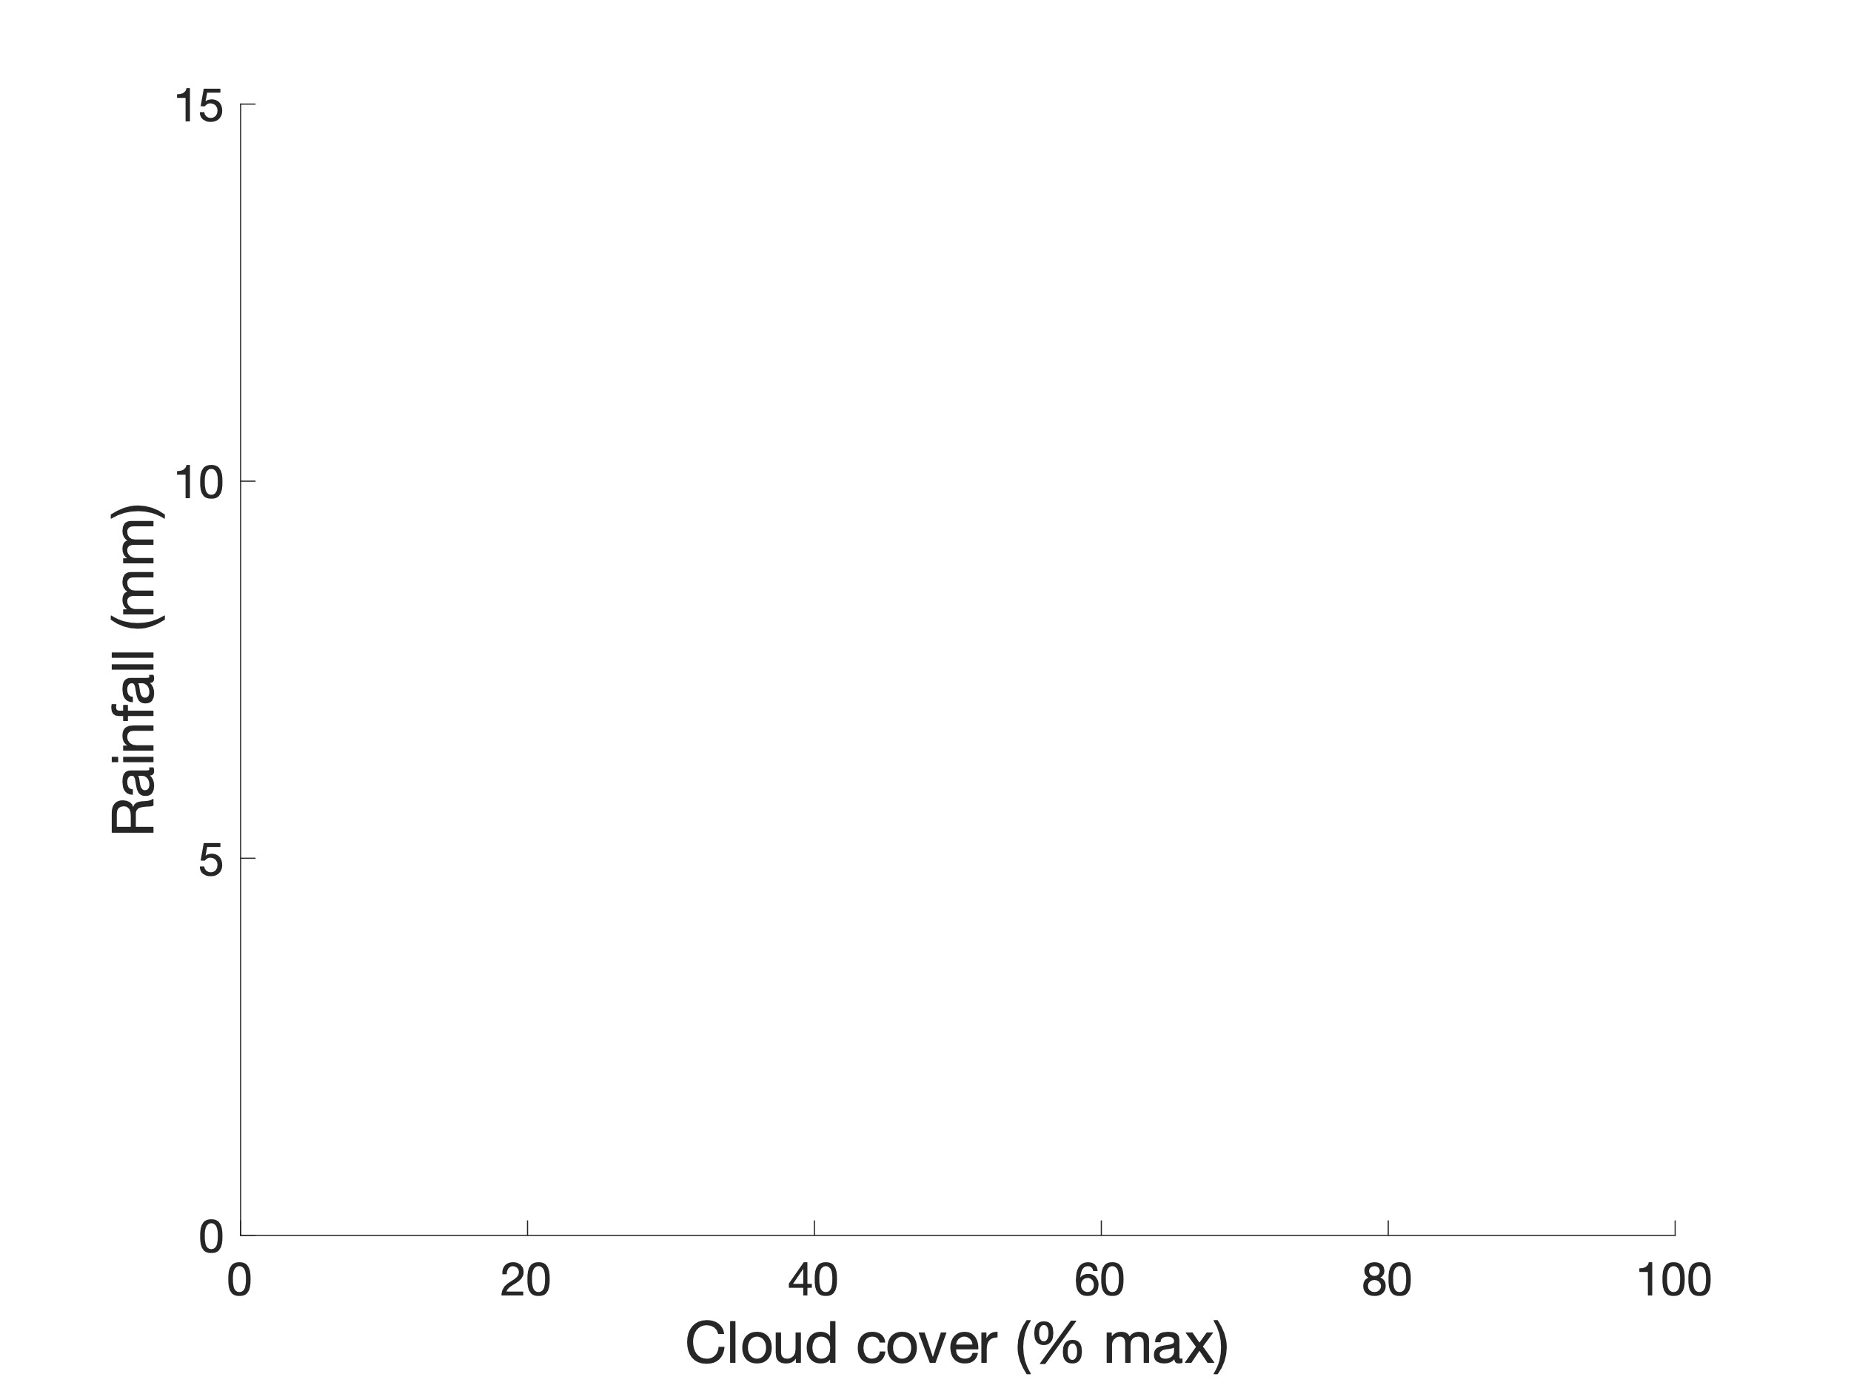
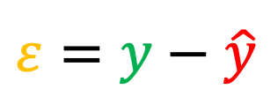

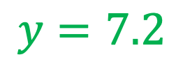


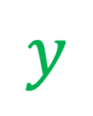
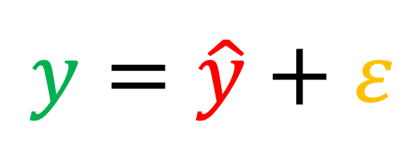



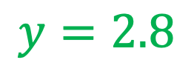
The linear model
$$y=\hat{y}+ε$$
$$ε=y−\hat{y}$$
$$=7.2−3.0$$
$$=4.2$$
$$y=7.2$$
$$\hat{y}=6.7$$
$$ε=−3.9$$
$$\hat{y}=3.0$$
$$y=2.8$$
$$y$$
50%
$$x$$
Notes:
Okay, that’s pretty mathy.
We can get a better intuition for how these symbols represent our model with a plot.
Going back again to our rainfall example: suppose we wake up and observe that the sky has 50% cloud cover (X). Since we’ve already fit a linear model, shown here as the red line, we can use this to predict how much rain there will be: Y hat equals 3 mm.
At the end of the day, however, it turns out there was 7.2 mm of rain. This is our observed value, hatless Y.
The error of our model can be determined by slightly rearranging the equation at top: Y minus Y hat equals 4.2 mm.
The same procedure can be repeated for other data points, such as this one, where the error is a negative value (since the model overestimated the rainfall by 3.9 mm)

Slide 11

Coming up...
How can we use our model error $ε$ to find the best possible linear model for our data?
Notes:
Hope you’re still with me!
In the next short video, we will find out how to use the model error, epsilon, to figure out what the best linear parameters are to fit our observations.

