Slide 1
Multiple Linear Regression
Part 3: Goodness of fit
Notes:
In this video, we will learn about how to use the linear model equations from the previous video, to determine which line best fits our observations.

Slide 2
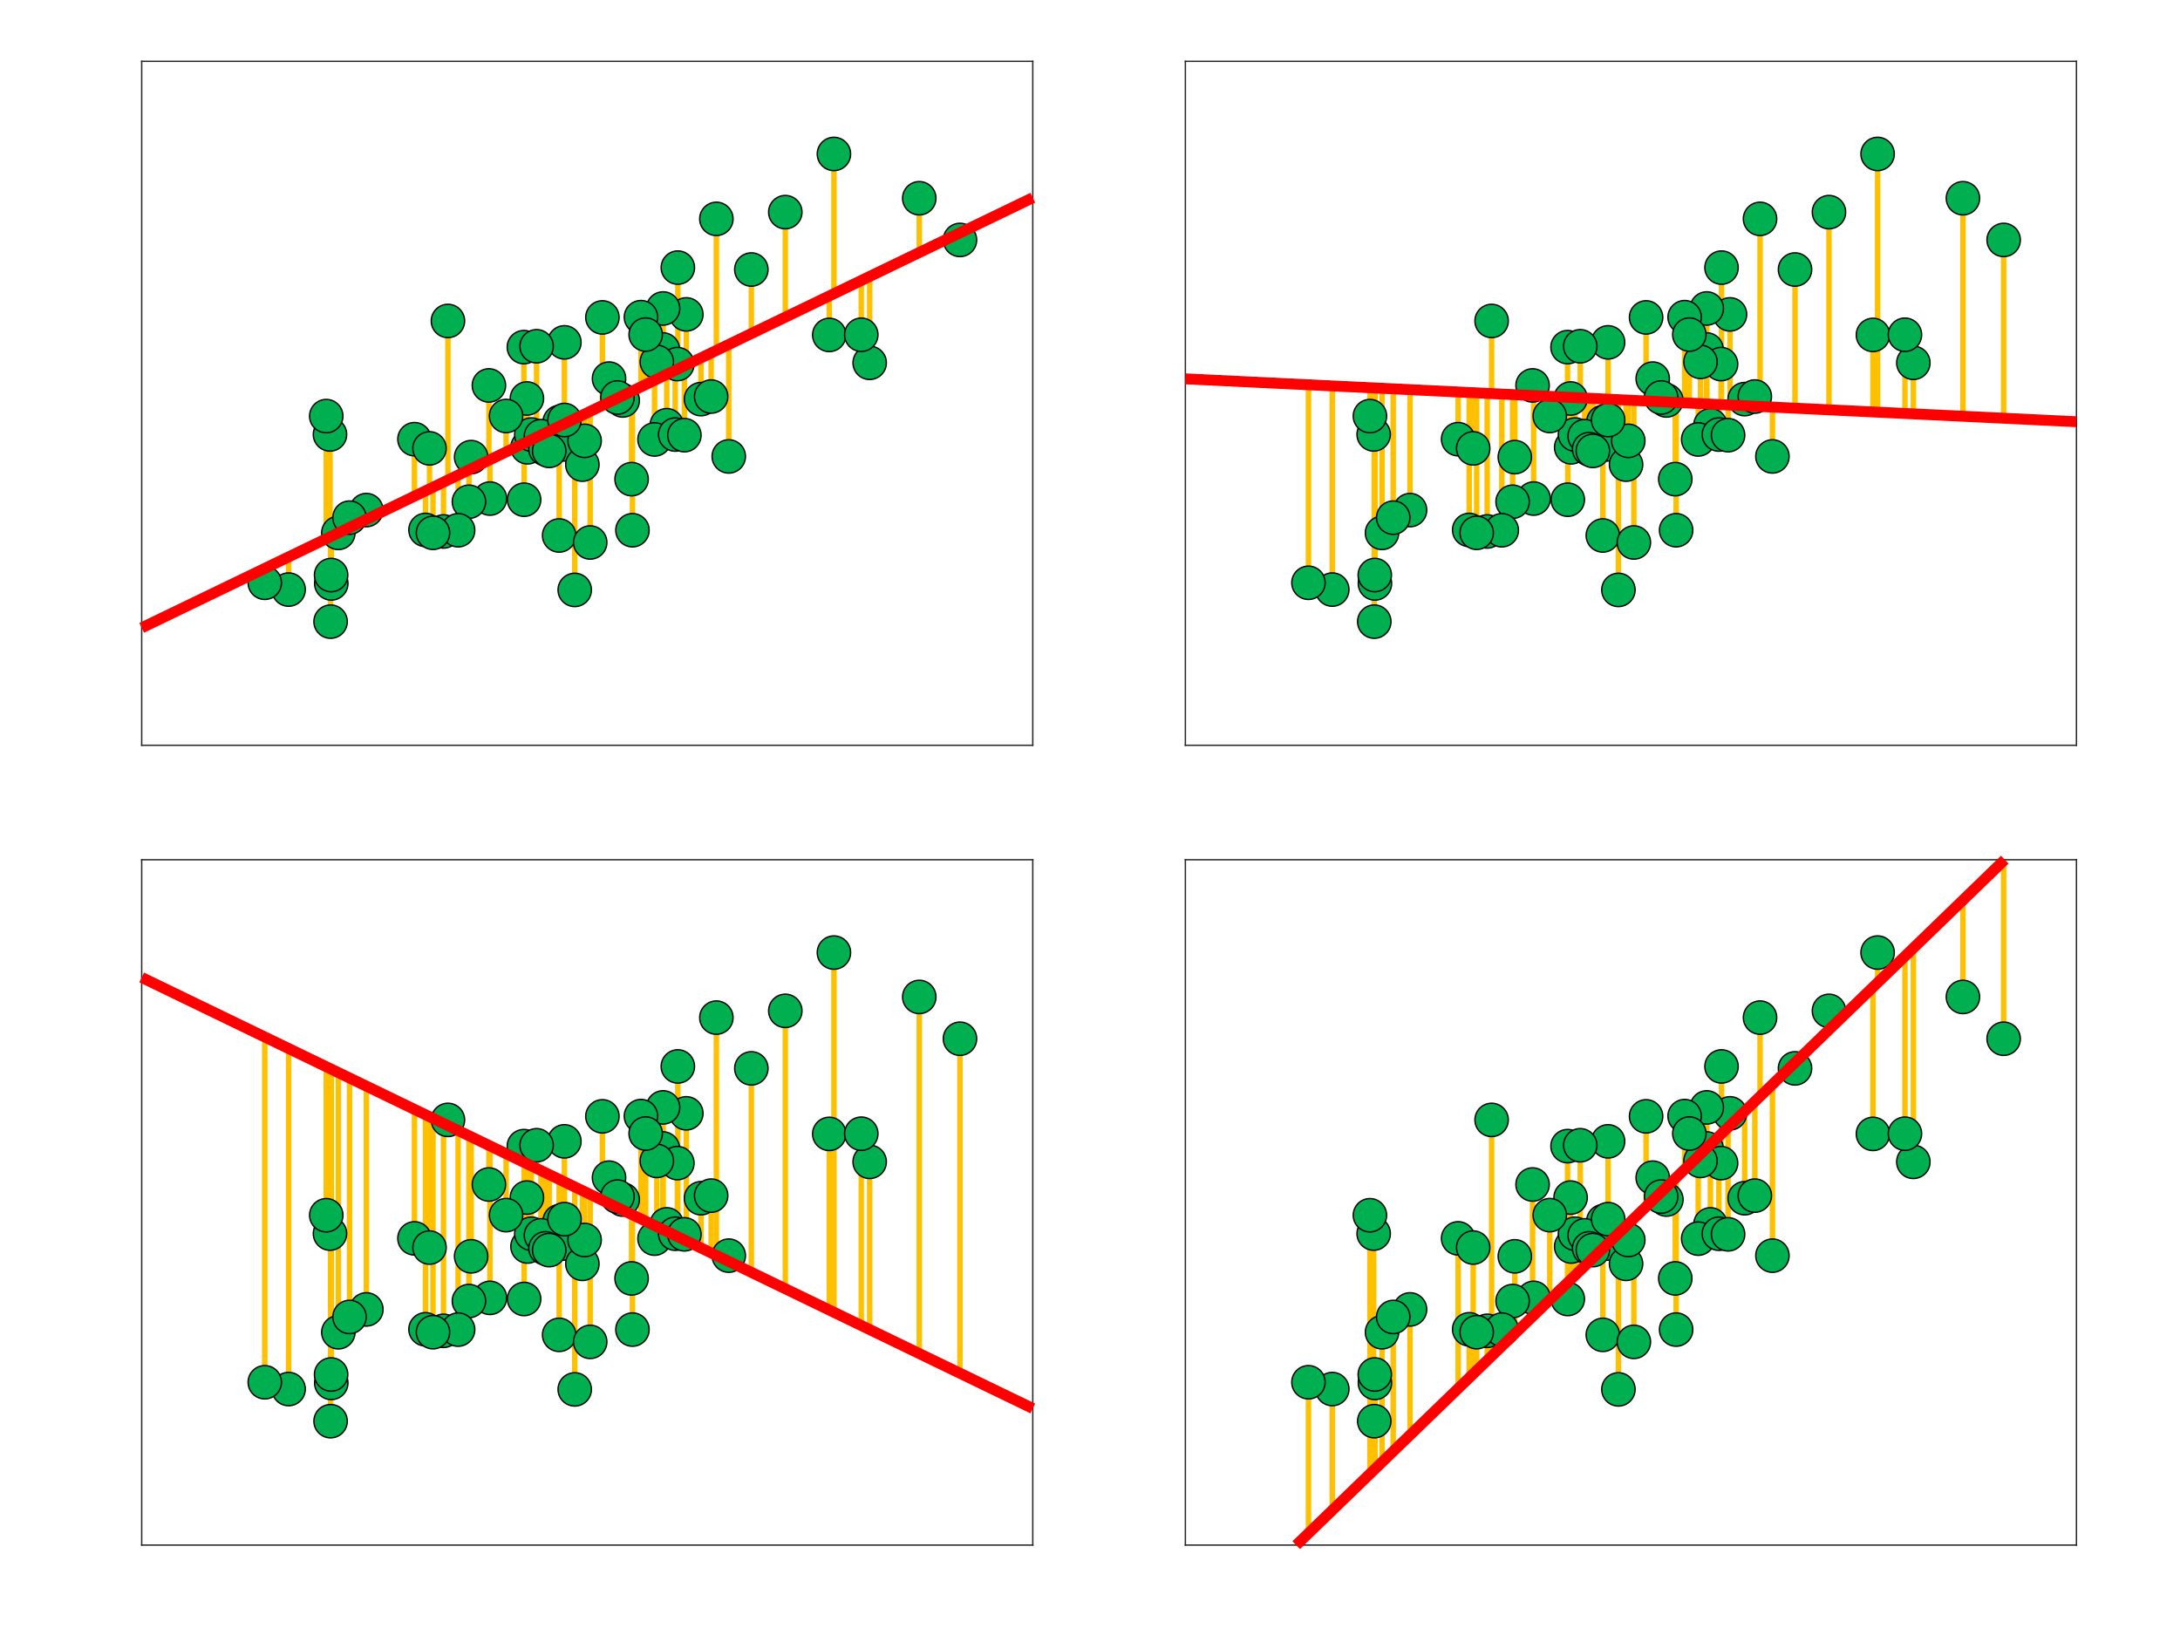
What makes a good fit?
Notes:
So how do we put a number on how good a job our line is doing at predicting our y variable?
Looking at these four plots, which do you think is the best fit? If I were to guess, I’d say the top left is the best and the bottom left is the worst, with the other two somewhere in between.
One

Slide 3

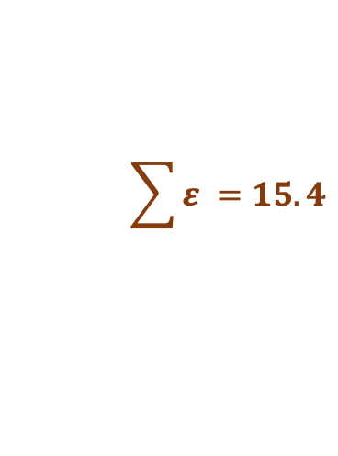
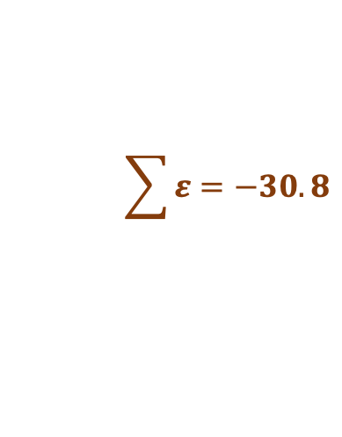
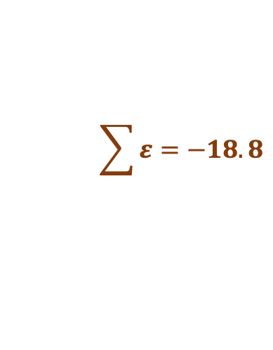
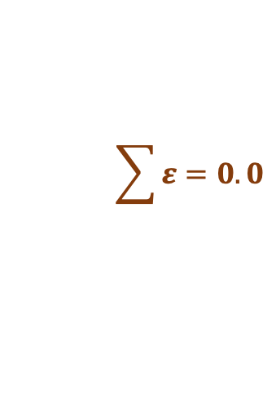
What makes a good fit?
$$\sum{ε}=0.0$$
$$\sum{ε}=−18.8$$
$$\sum{ε}=−30.8$$
$$\sum{ε} =15.4$$
Notes:
The fit should actually reflect the length of the yellow lines. How about if we just added the residual error up across all the observations?
[click]
Oops, this doesn’t give us what we want. That’s because, for a given line, we’ll usually have both positive errors (above the line) and negative errors (below the line), and these tend to cancel each other out when we sum them.

Slide 4

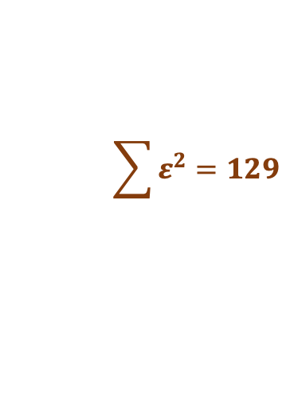


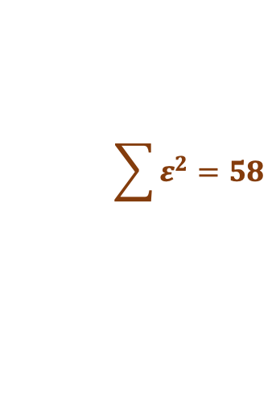
What makes a good fit?
$$\sum{ε^{2}}=58$$
$$\sum{ε^{2}}=145$$
$$\sum{ε^{2}}=340$$
$$\sum{ε^{2}}=129$$
Notes:
But look at this: when we SQUARE the error values, they all become positive, and this sum of squares gives us the ordering we want.
Sums of squares are commonly used to get a single value to quantify the goodness of fit of a line to a set of data points.

Slide 5
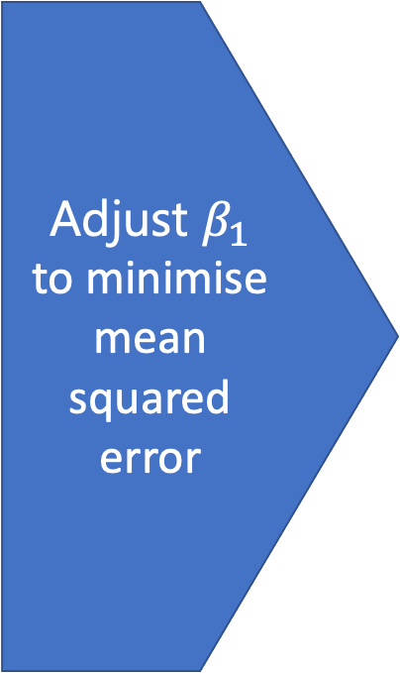

What makes a good fit?
Adjust $β_{1}$
to minimise mean squared error
Notes:
In this interactive plot, we can see directly how the mean sum of squares (or MSE) changes when we change the slope of our line, beta 1.
In the lower figure, we can see the relationship of MSE with the beta 1 parameter. It forms an inverted-U pattern, with a minimum value around 0.65.
In general, we can find the line of best fit to any well-distributed data set by finding the parameters corresponding to the minimum MSE.
Later in this Xerte toolkit, you’ll be able to explore this plot yourself.

Slide 6
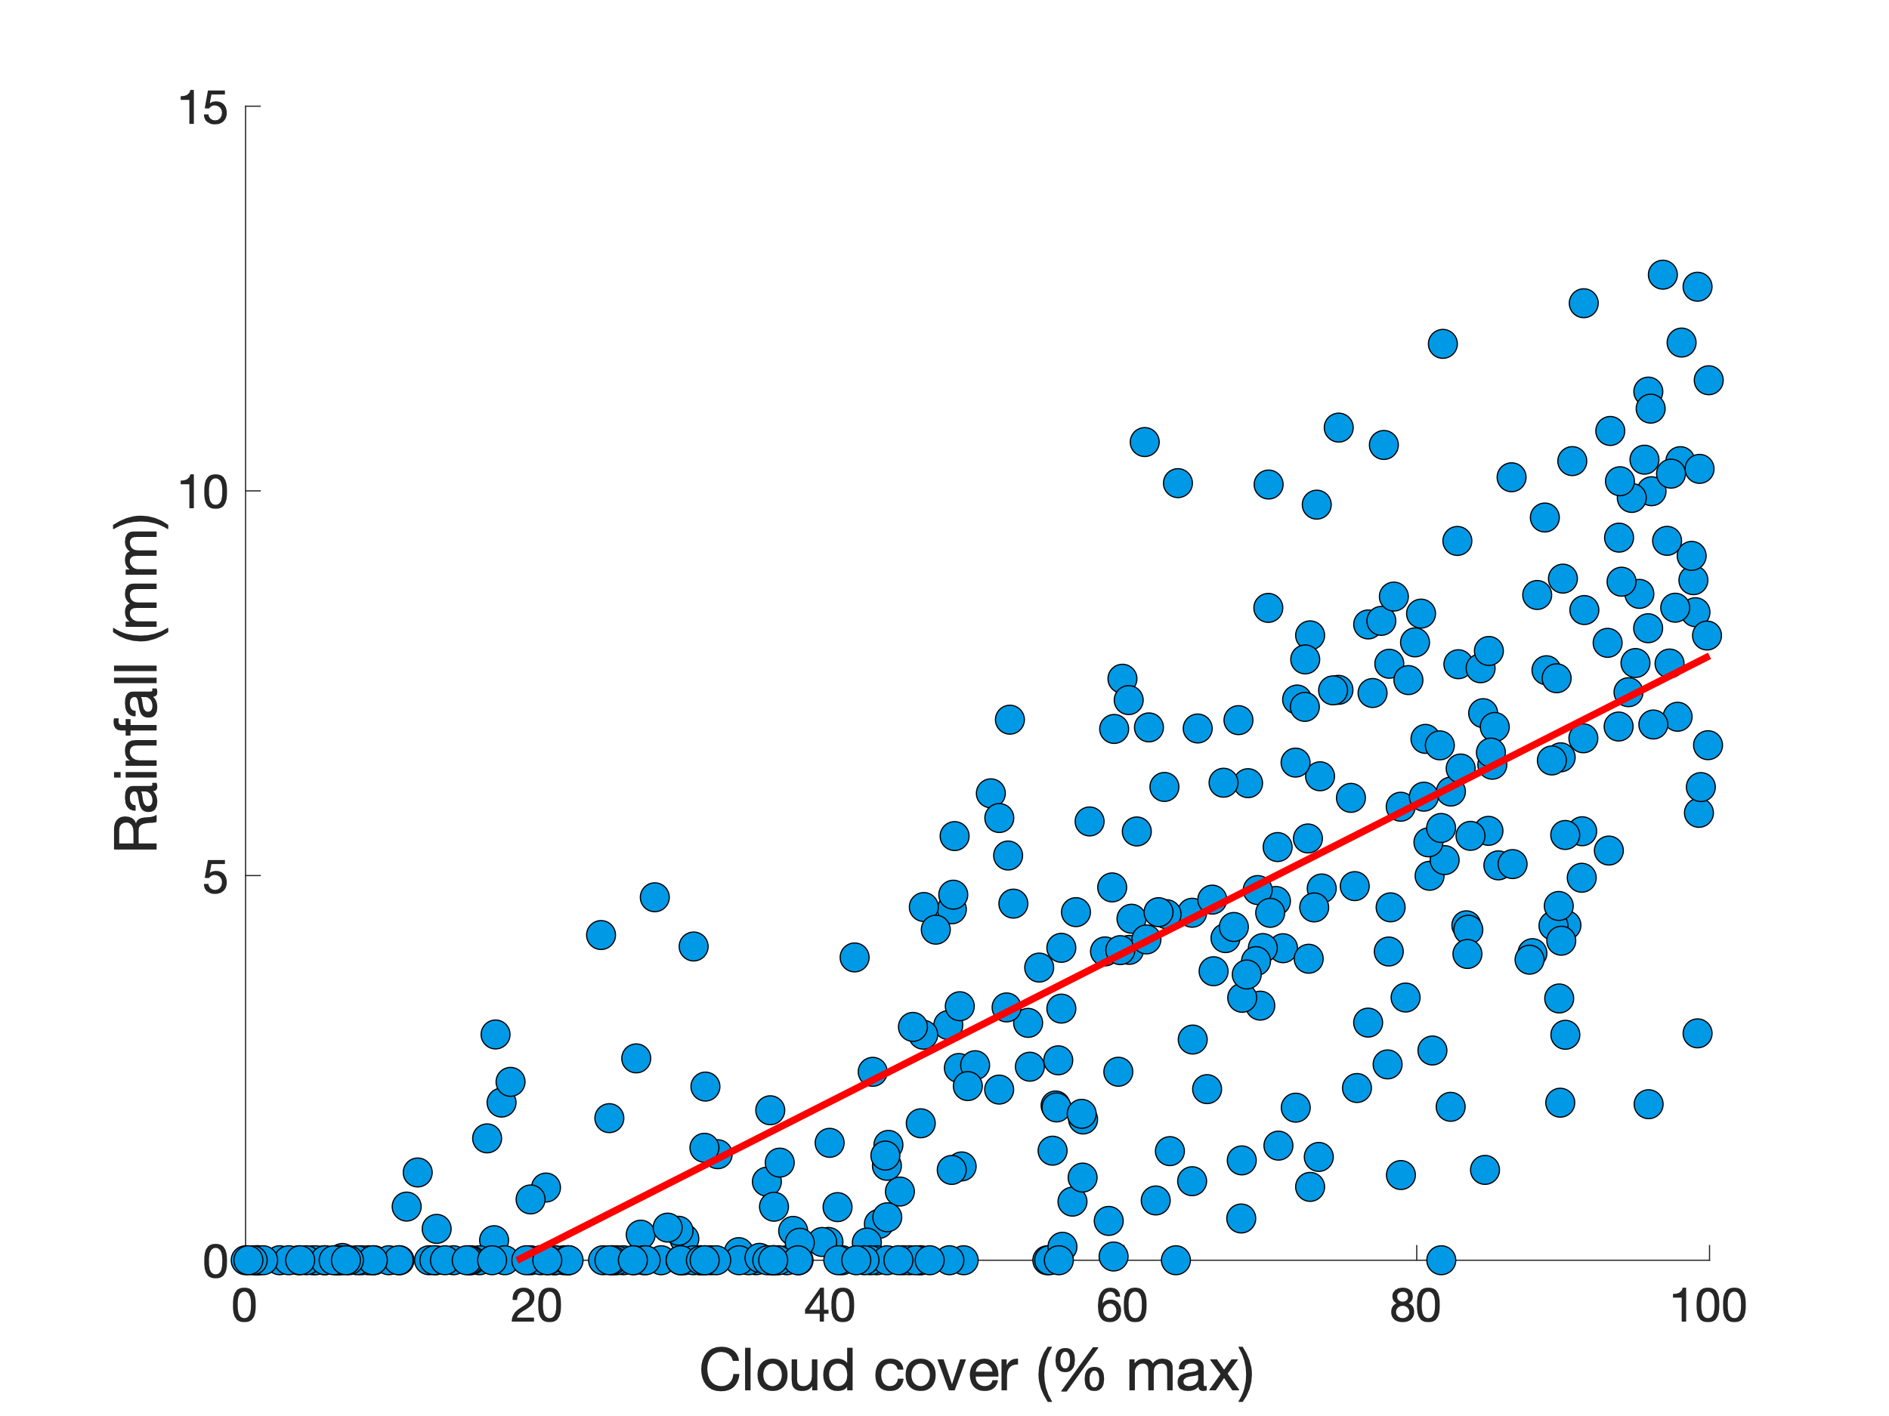
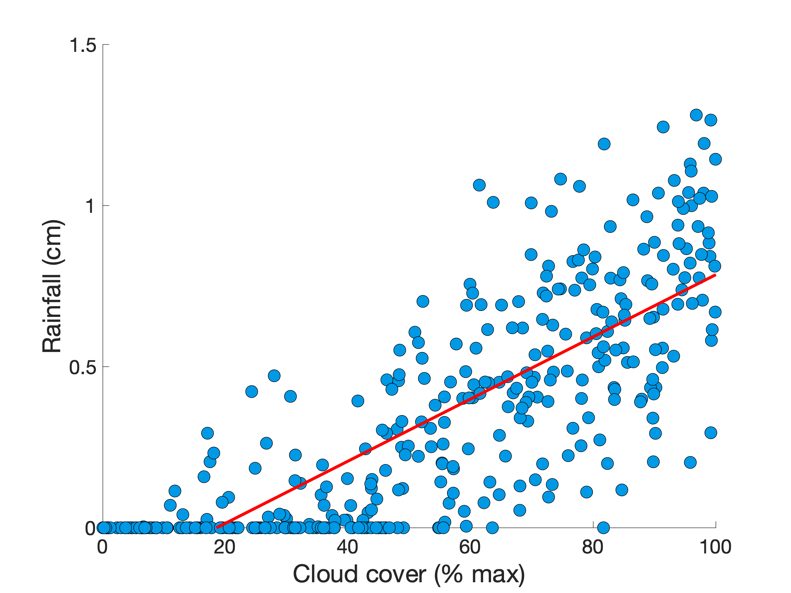

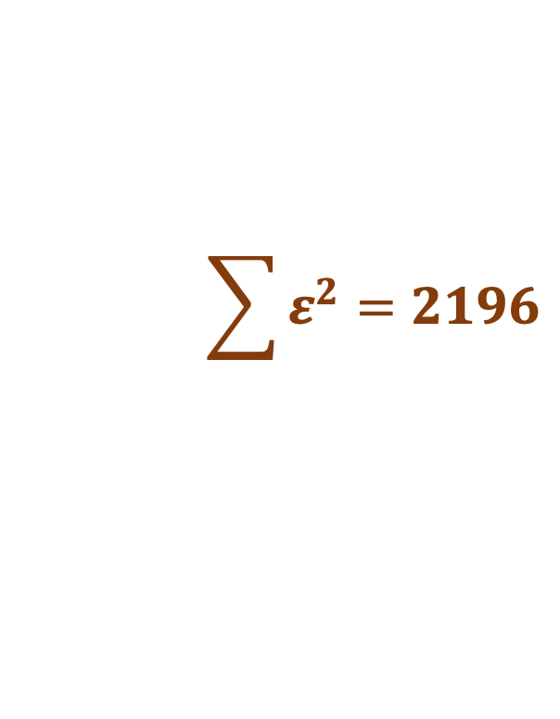
How good is my model fit?
$$\sum{ε^{2}}=2196$$
$$\sum{ε^{2}}=21.96$$
Notes:
Okay, so far we’ve figured out how we can determine the line that best fits our data. But can we also quantify how good that fit is?
You might say: well, just use the mean sum of squares!
It’s a great idea, but there’s a hitch.
Check out these two plots. The look identical, right?
In fact, they ARE identical, except for the fact that the measurement on the Y-axis uses different units (mm and cm)
The corresponding sums of squared errors are very different from one another!
Clearly, we need a measure of goodness of fit that accounts for this difference in scale.

Slide 7
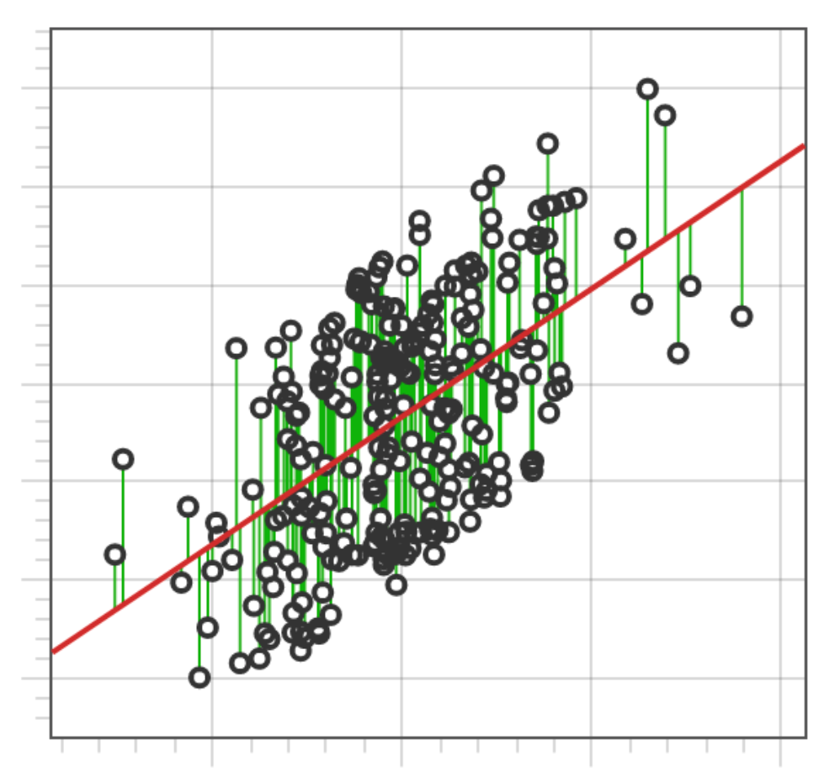
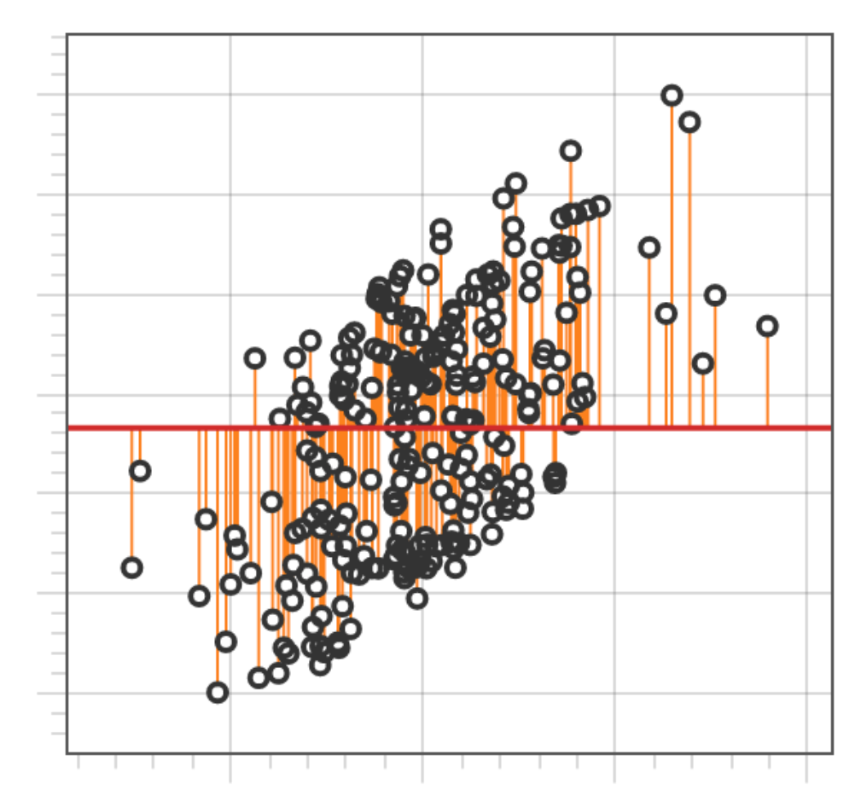
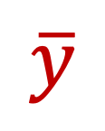

How good is my model fit?
$$\hat{y}$$
$$\overline{y}$$
Residual Error
Total Error
Notes:
We can deal with this issue by considering the RATIO of residual error, on the left, to total error, on the right.
Residual error is how far data points fall from the predicted value of y, y hat.
Total error, on the other hand, is how far data points fall from the MEAN value of y, y bar.

Slide 8
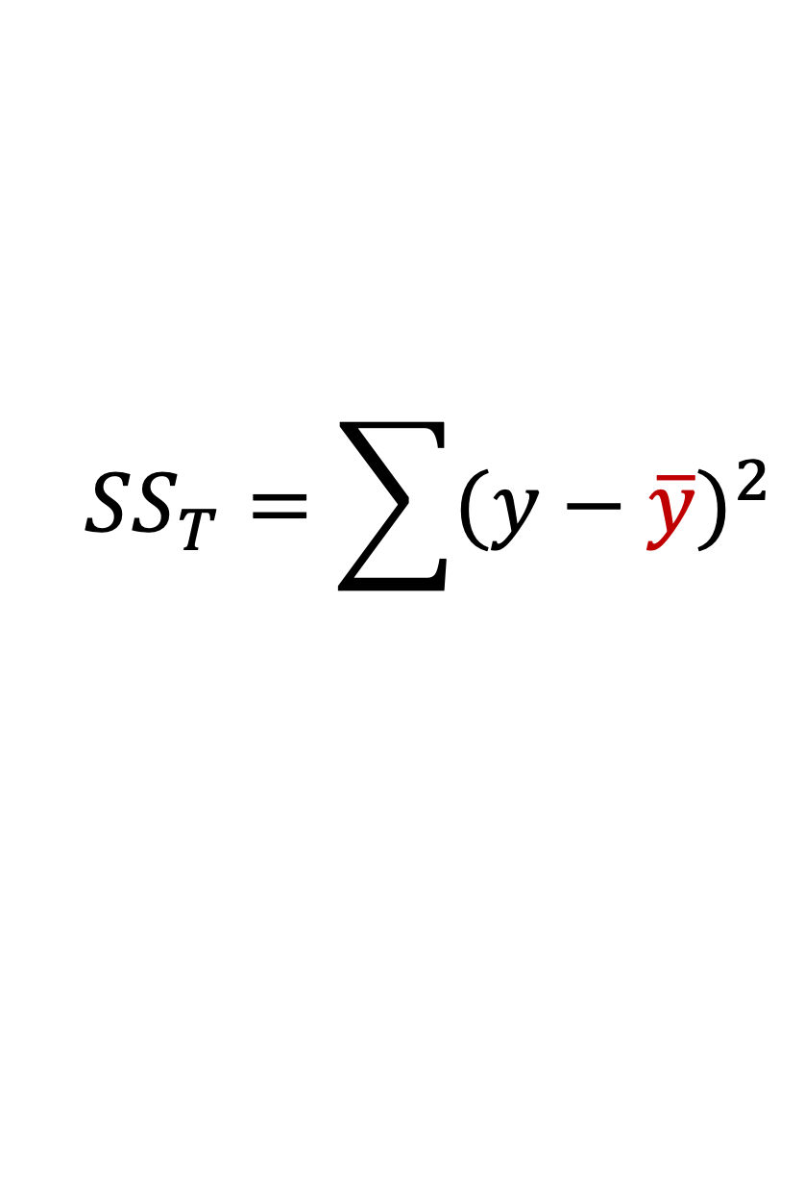

How good is my model fit?
$$\hat{y}$$
$$\overline{y}$$
$${SS}_{R}=\sum{{(y−\hat{y})}^{2}}$$
$${SS}_{T}=\sum{{(y−\overline{y})}^{2}}$$
Residual Error
Total Error
Notes:
These errors are used to compute a residual sum of squares, SS R
and a total sum of squares, SS T
SS R tells us how much uncertainty we have about Y after accounting for our predictor variable X; in other words, its variability around the linear model.
While SS T tells us how much uncertainty we have about Y on its own; in other words, its variability around its mean.

Slide 9
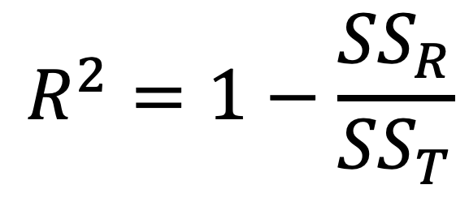
How good is my model fit?
$$R^{2}=1−\frac{{SS}_{R}}{{SS}_{T}}$$
Notes:
Putting these types of error into one equation gives us a single value that quantifies our goodness of fit, R squared.

Slide 10
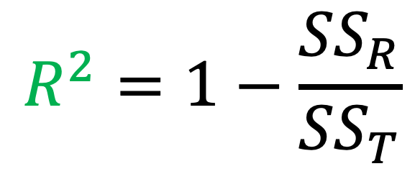
How good is my model fit?
$$R^{2}=1−\frac{{SS}_{R}}{{SS}_{T}}$$
coefficient of determination
Notes:
This value, also called the “coefficient of determination”, has a number of useful properties.

Slide 11
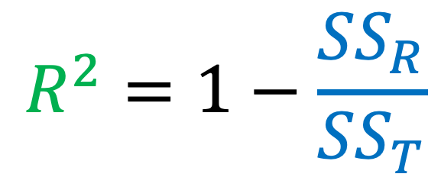
How good is my model fit?
unitless
$$R^{2}=1−\frac{{SS}_{R}}{{SS}_{T}}$$
coefficient of determination
Notes:
Firstly, because the ratio SS R to SS T is derived from the same variable, the units of that variable cancel out – and we are left with a value that is the same regardless of whether those units are mm, cm, or anything else.
Secondly, this ratio tells us how much better we can predict our variable Y when we have knowledge of X (SS R), as a fraction of how well we can predict it without (SS T).

Slide 12
How good is my model fit?
unitless
$$R^{2}=1−\frac{{SS}_{R}}{{SS}_{T}}$$
coefficient of determination
Notes:
Let’s consider two extremes:

Slide 13
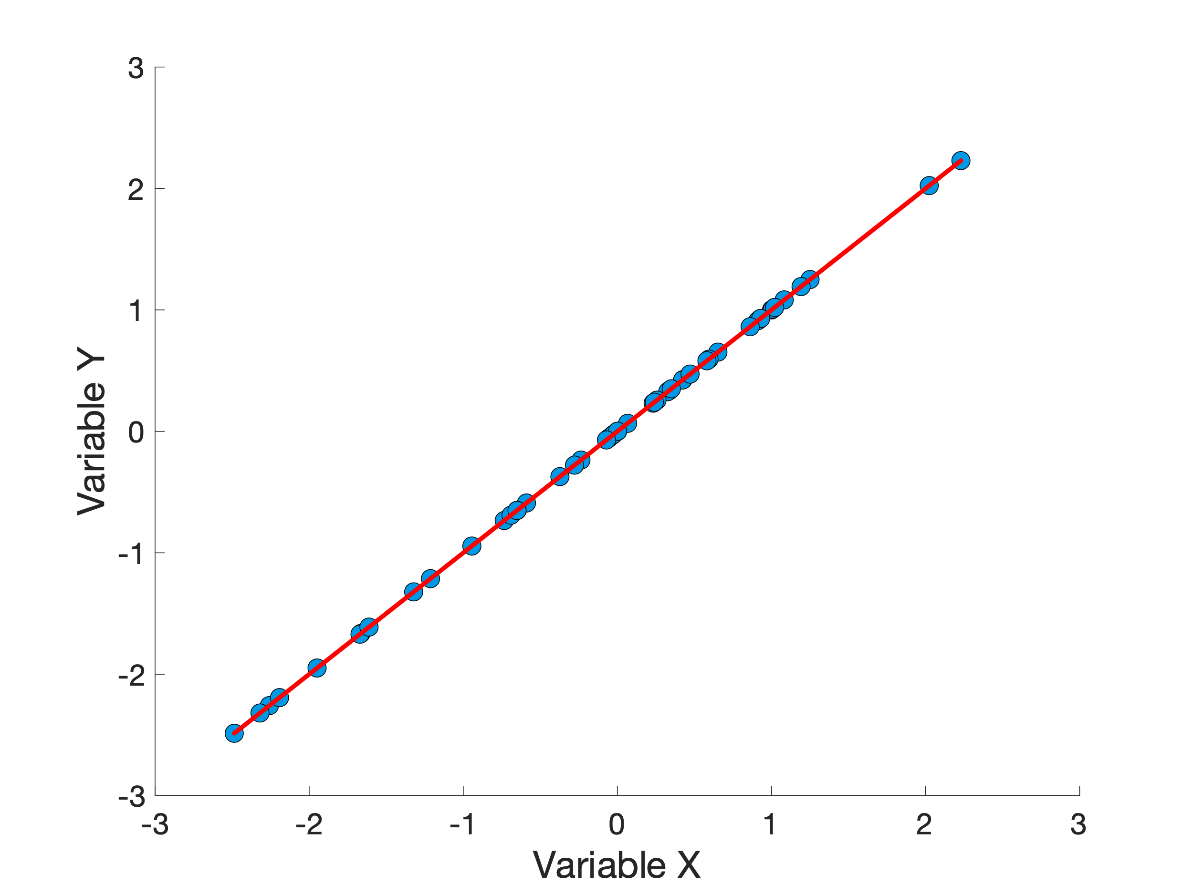
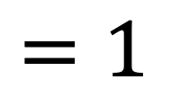
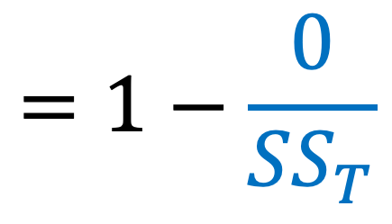

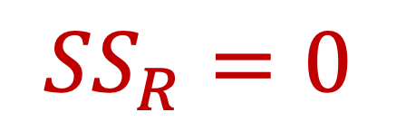
How good is my model fit?
$$R^{2}=1−\frac{{SS}_{R}}{{SS}_{T}}$$
$${SS}_{R}=0$$
$$=1−\frac{0}{{SS}_{T}}$$
$$=1$$
Notes:
Let’s consider two extremes:
In this plot, our observations agree perfectly with our predictions, meaning that X perfectly predicts Y.
All the points line up with the model, which means that the sum of squared residual error is ZERO.
In this case, R^2 turns out to be ONE

Slide 14
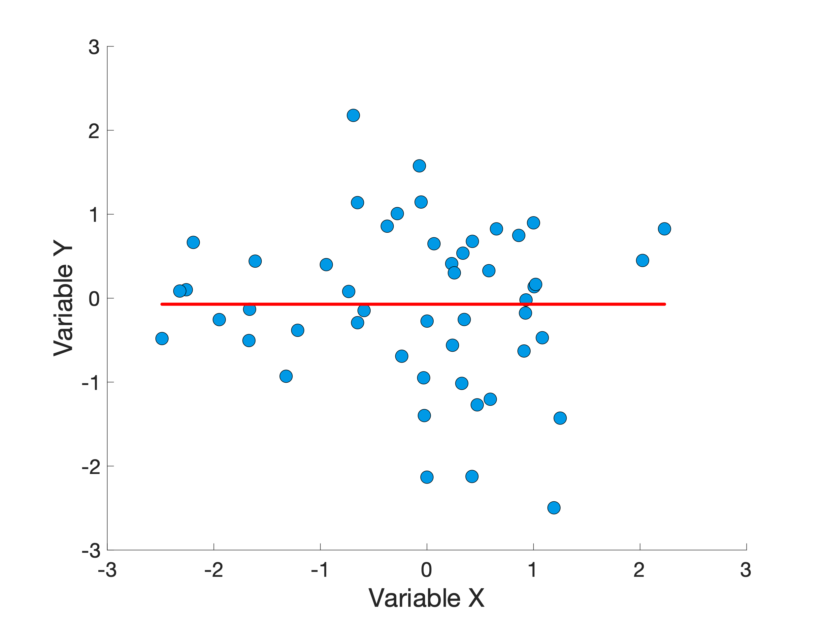
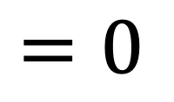
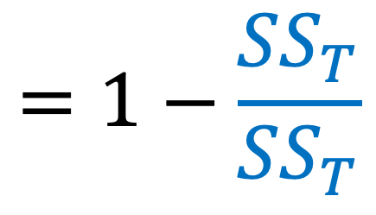

How good is my model fit?
$$R^{2}=1−\frac{{SS}_{R}}{{SS}_{T}}$$
$${SS}_{R}={SS}_{T}$$
$$=1−\frac{{SS}_{T}}{{SS}_{T}}$$
$$=0$$
Notes:
Let’s consider two extremes:
In this plot, on the other hand, X has absolutely no relationship with Y.
In this case, our residual error is identical to our total error, and R^2 turns out to be ZERO.
Which brings us to the third useful property of R^2: it varies from 0 (meaning no association between X and Y) and 1 (meaning perfect association)

Slide 15
Coming up...
How can we look at more than one predictor variable?
Notes:
Hopefully you have a better idea at this point both how to find the best fitting line for two observed variables, and how to quantify the goodness of fit using the coefficient of determination, R^2. In the next video, we will see how this approach can be extended to include more than two variables – the “multiple” in multiple linear regression.

