Slide 1
Multiple Linear Regression
Part 5: Statistical inference on linear models
Notes:
In this video, we’ll learn about how to go from a fitted linear model to an inference about whether we can generalise from our sample to the population, using an F-ratio null hypothesis test.

Slide 2
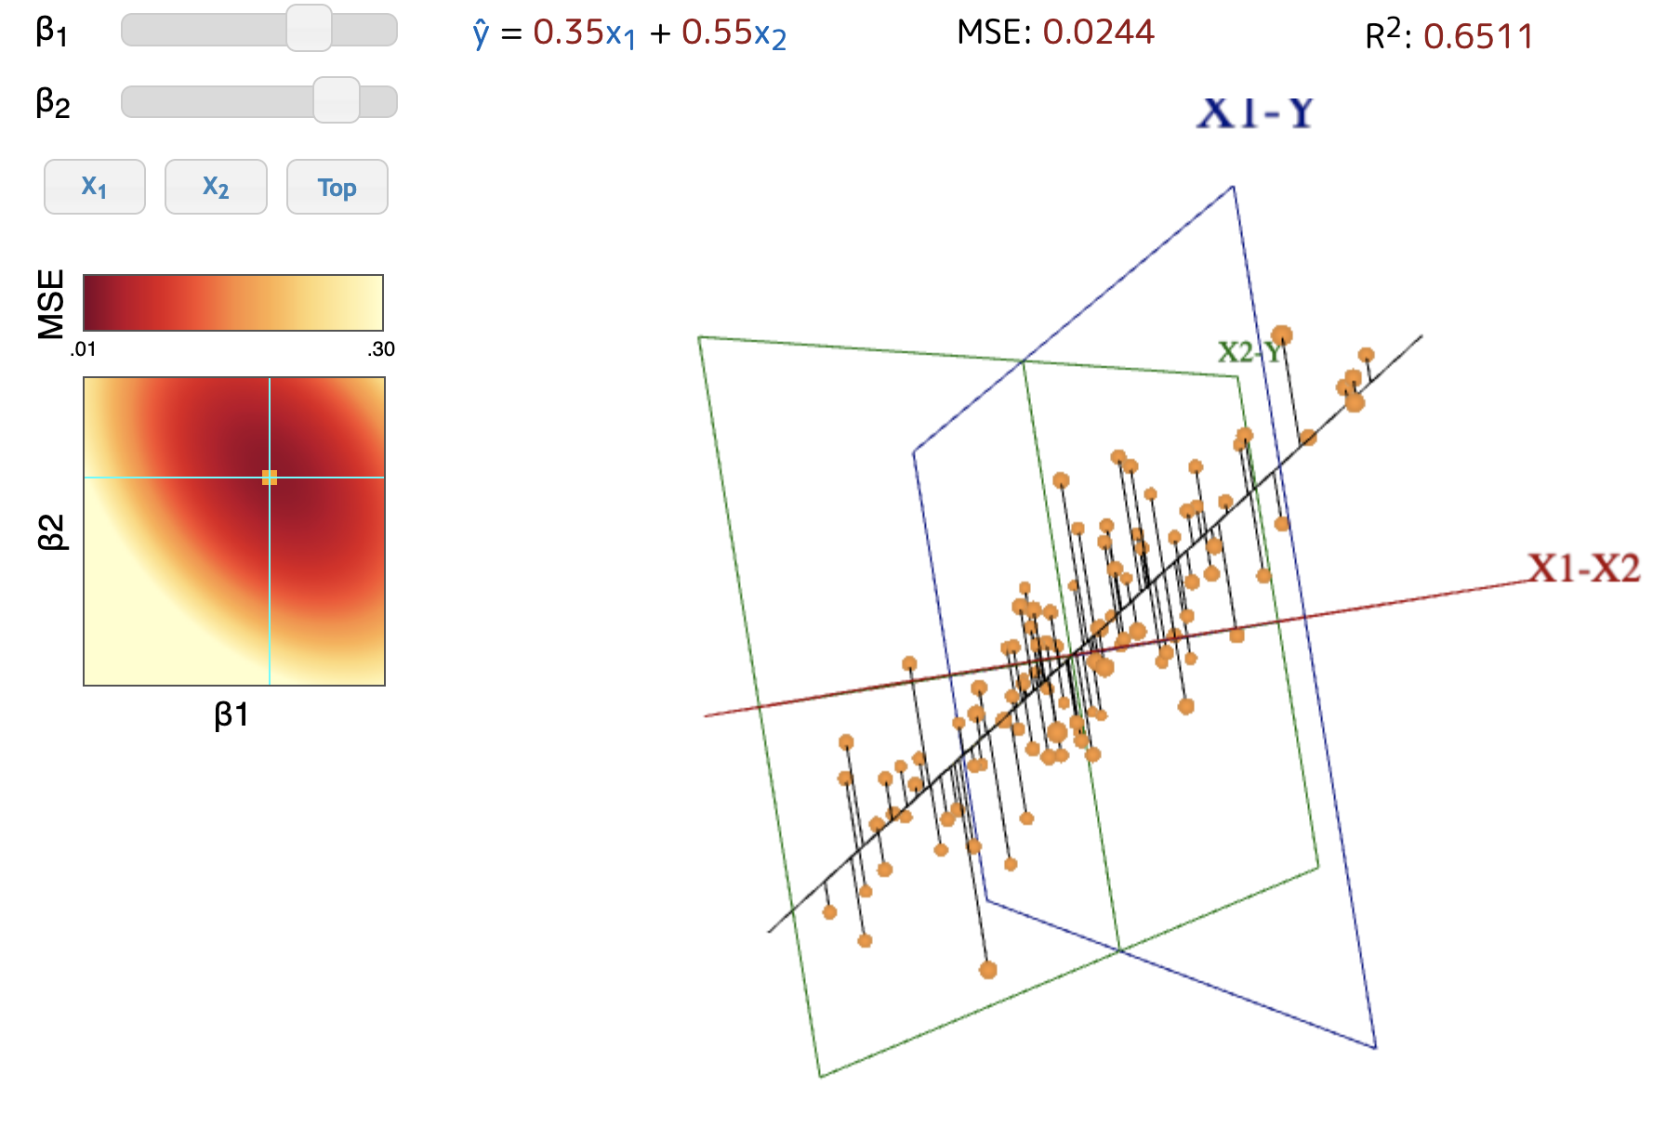

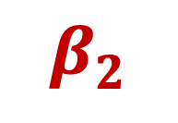
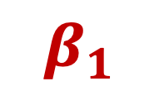
$$β_{1}$$
$$β_{2}$$
$$R^{2}$$
Notes:
In the previous video, we looked at how to adjust our beta parameters to best fit a model with two predictor variables.
For our example, the best fit had beta coefficients of 0.35 and 0.55, and an R^2 of 0.65, indicating the amount of explained variance.

Slide 3
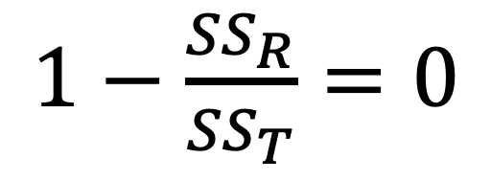
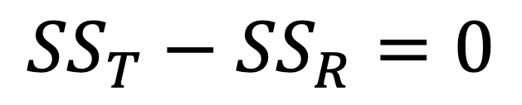
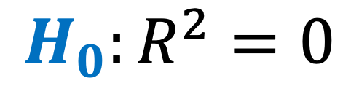
Does this result generalise?
$$H_{0}:R^{2}=0$$
$1−\frac{{SS}_{R}}{{SS}_{T}}=0$
$${SS}_{T}−{SS}_{R}=0$$
Notes:
But this model was only fit to a sample. In statistics, we want to know how likely it is that this sample represents the population in general. Should we expect to see the relationships between our outcome and predictor variables with other random samples drawn from the population?
In other words, does our result generalise?
To test this, we first need to formulate a null hypothesis: in this case, we hypothesise that no relationship exists in the population, which corresponds to an R^2 of zero.
If we look at the equation for R^2, this is equivalent to saying that the difference between the total and residual sums of squares is zero; or, in other words, that our model explains the outcome variable no better than its mean.

Slide 4
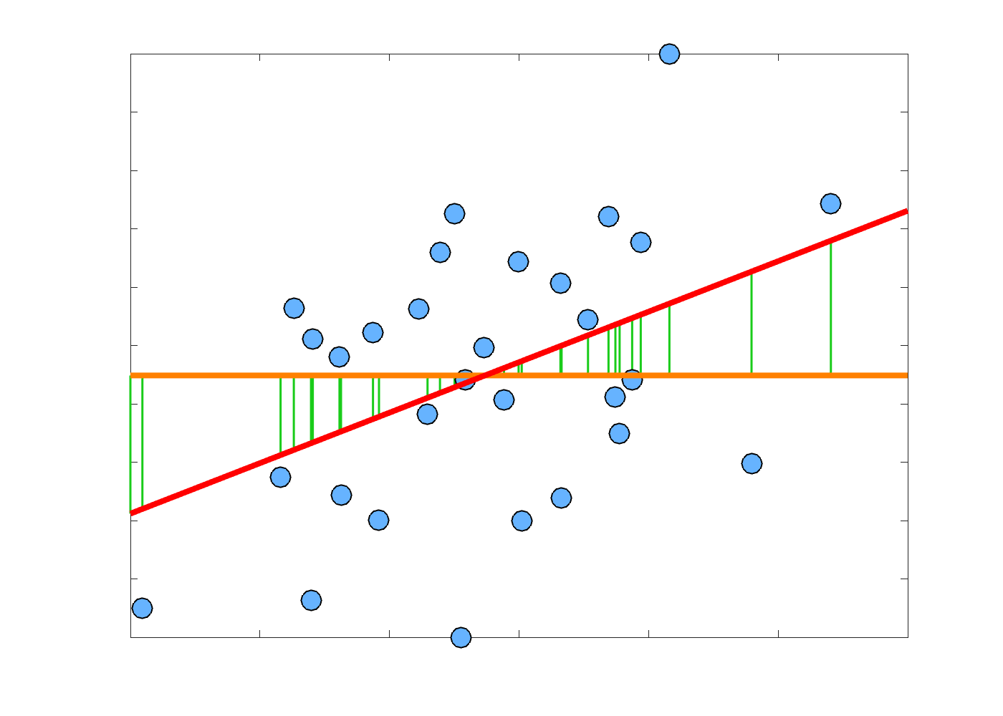
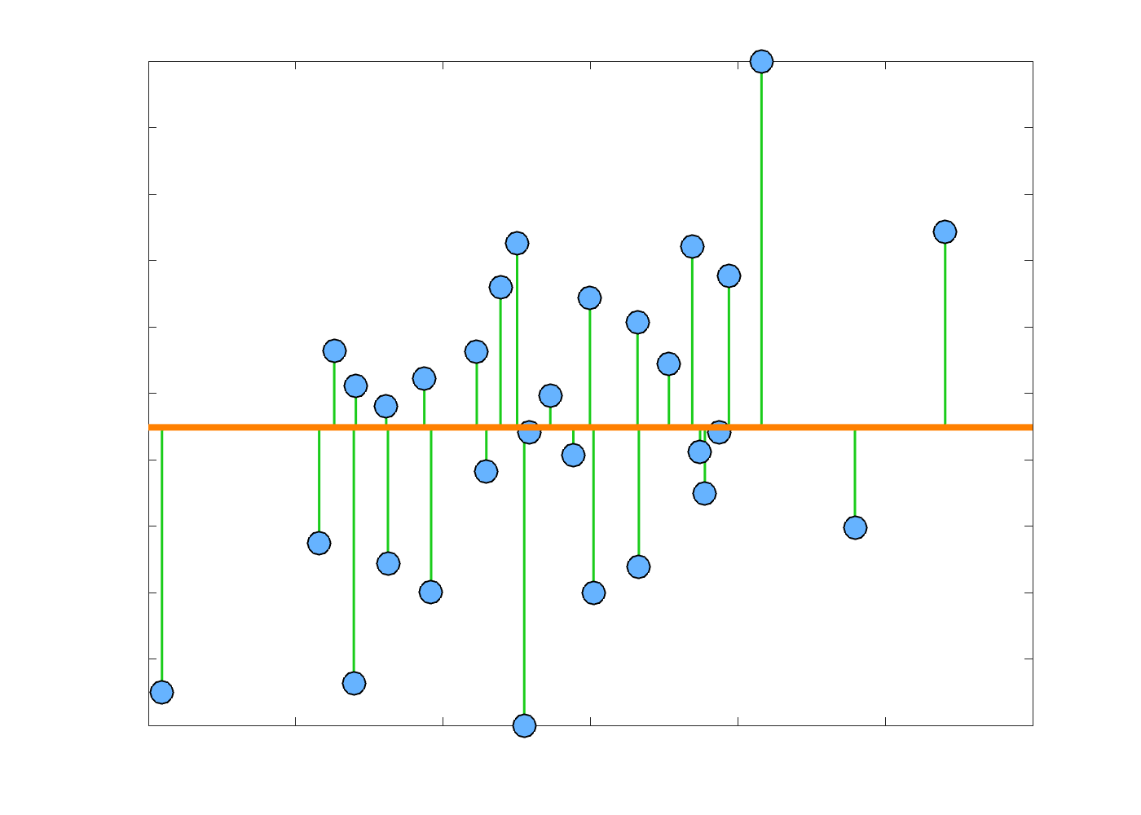
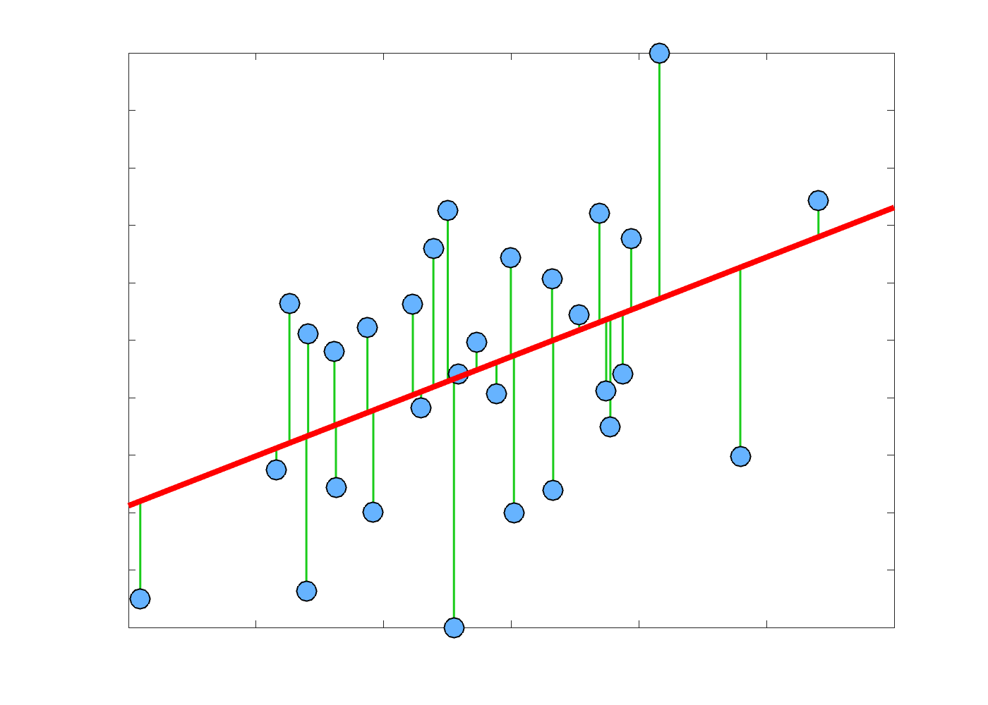
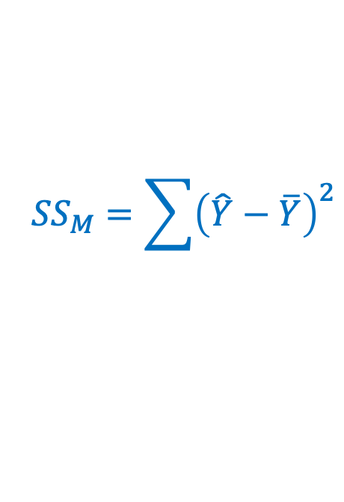
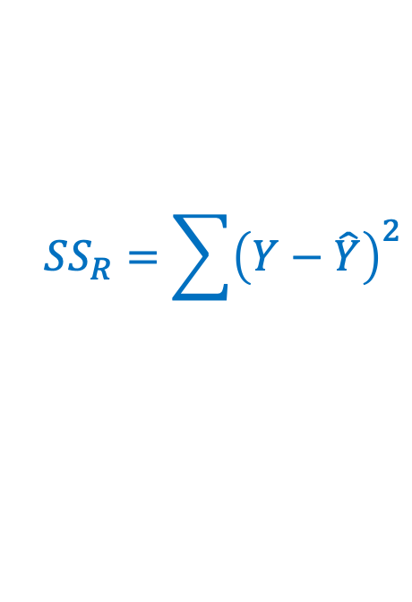
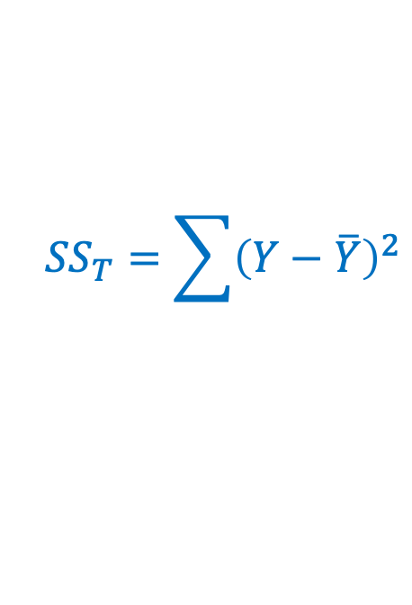


$${SS}_{M}=\sum{{\left(\hat{Y}−\overline{Y}\right)}^{2}}$$
$$=$$
$${SS}_{T}=\sum{{\left(Y−\overline{Y}\right)}^{2}}$$
$$−$$
$${SS}_{R}=\sum{{\left(Y−\hat{Y}\right)}^{2}}$$
Notes:
Remember that we looked at this previously: here are plots showing the total and residual sums of squares.
This difference actually has its own name: the model sums of squares. This is a measure of how much the model differs from the mean. Clearly, if this is zero, our null hypothesis is true, but the further it is from zero (relative to the residual error), the less likely the null hypothesis is true.

Slide 5
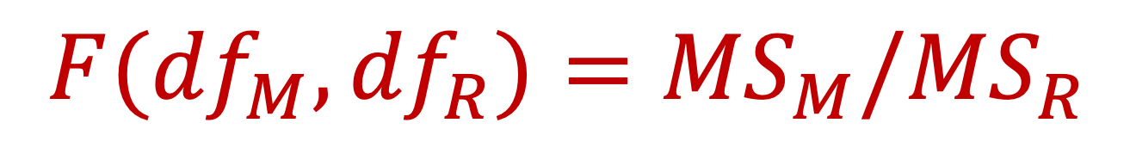
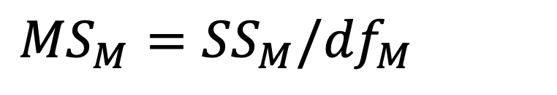

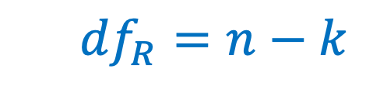
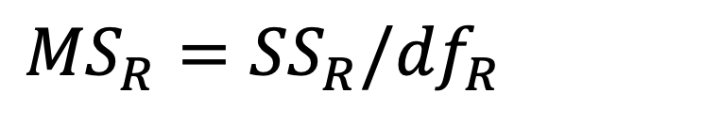
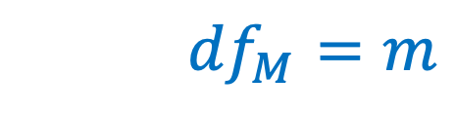
F-ratio for linear regression
$${MS}_{M}={SS}_{M}/{df}_{M}$$
$${df}_{M}=m$$
$${MS}_{R}={SS}_{R}/{df}_{R}$$
$${df}_{R}=n−k$$
$$=n−m−1$$
$$F({df}_{M},{df}_{R})={MS}_{M}/{MS}_{R}$$
Notes:
We can capture this relationship with an F-ratio. As you may recall from learning about ANOVA, this F-ratio is a ratio of MEAN sums of squares, which are computed by dividing the sums of squares by their corresponding degrees of freedom.
The degrees of freedom for our model is simply m. Recall from our previous videos that m is the number of dimensions in our model. For the example we saw earlier, m equals 3.
The residual degrees of freedom is computed as n (our sample size) minus k, which is the number of predictor variables. Since k is one less than m, this can also be written as n minus m minus 1.
Once we have our mean sums of squares, we derive an F-ratio as the ratio of model to residual mean sums of squares. Recall that in a previous video, you learned why we need to take a ratio here: this makes the statistic unitless, and therefore independent of the scale of the variables we’re analysing.
For our rainfall example, the F-ratio will be the same whether we measure rainfall in mm or cm.
The F-ratio has a probability distribution that depends on the two degrees of freedom. We can test our null hypothesis by comparing our F-ratio to this distribution.

Slide 6
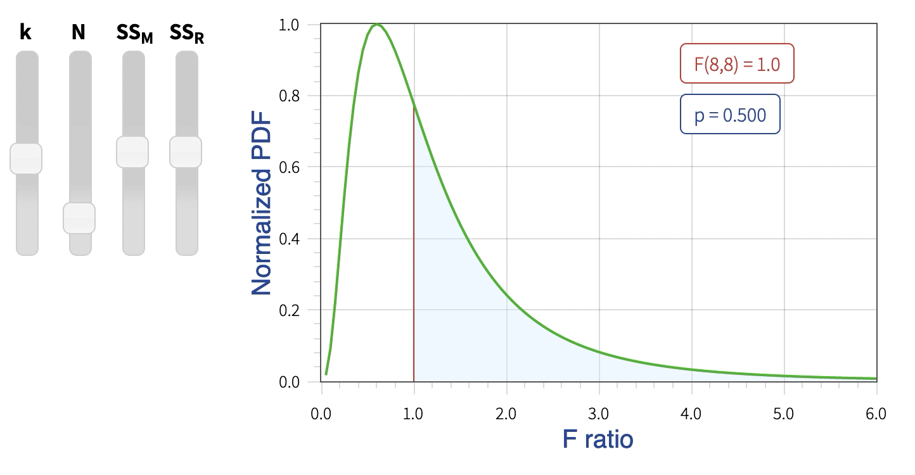
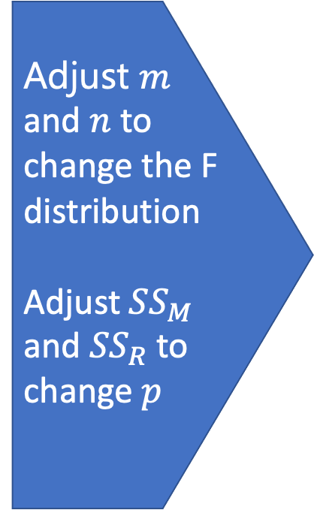
The F-ratio distribution
Adjust $m$ and $n$ to change the F distribution
Adjust ${SS}_{M}$ and ${SS}_{R}$ to change $p$
Notes:
This interactive plot, which you can play with yourself in this Xerte toolkit, shows how the shape of the F distribution, under the null hypothesis, depends on k and n. It also shows how the p value depends on the two types of variance: model and residual.
The green curve shows the probability density function for the F-ratio at given values of k and n, and the blue shaded area shows the probability of finding F-ratios at the red line or higher, when the null hypothesis is true.
Recall that the F-distribution is a sampling distribution: it tells us how likely it is to get a particular F-ratio from another random sample under the null hypothesis. The peak of the F-distribution is the most likely F-ratio you can expect to find. Higher F-ratios are decreasingly likely.
Increasing the number of predictor variables makes the distribution more peaked, meaning it’s less likely to get very high F-ratios.
Increasing n has a similar effect on the distribution.
Increasing the model sums of squares reduces the p value, while increasing the residual sums of squares increases it.

Slide 7
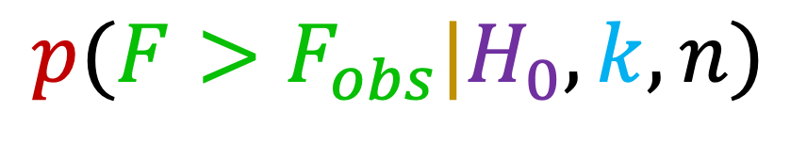
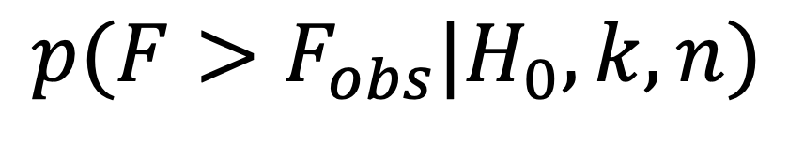
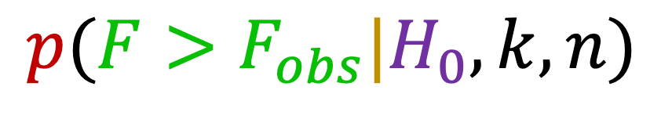
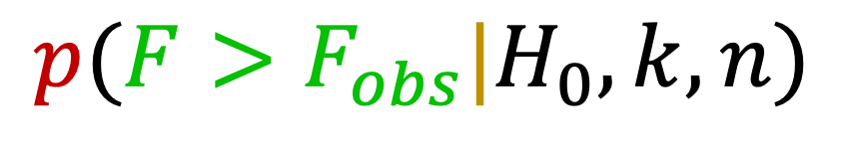
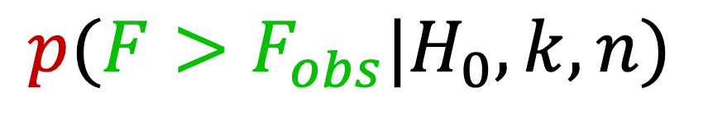
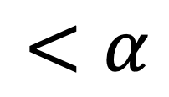
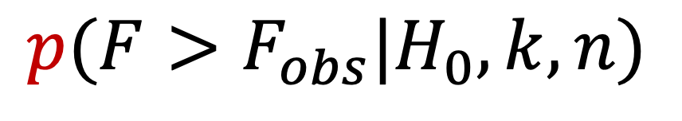
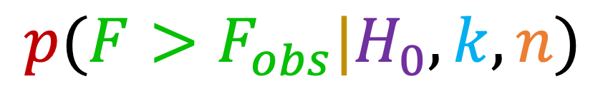
$$p(F>F_{obs}|H_{0},k,n)$$
$$<α$$
$$p(F>F_{obs}|H_{0},k,n)$$
$$p(F>F_{obs}|H_{0},k,n)$$
$$p(F>F_{obs}|H_{0},k,n)$$
$$p(F>F_{obs}|H_{0},k,n)$$
$$p(F>F_{obs}|H_{0},k,n)$$
$$p(F>F_{obs}|H_{0},k,n)$$
Probability
Probability of observing this F-ratio or higher
Probability of observing this F-ratio or higher given that
Probability of observing this F-ratio or higher given that the null hypothesis is true,
Probability of observing this F-ratio or higher given that the null hypothesis is true, k predictor variables
Probability of observing this F-ratio or higher given that the null hypothesis is true, k predictor variables, and sample size n
Notes:
This is what our p value – the blue shaded area from the that F-distribution plot - looks like when written out. It looks complicated, but let’s break it down.
We are looking at the [click] probability, P, of [click] observing this F-ratio or higher [click] given that [click] the null hypothesis is true, [click] k predictor variables, and [click] sample size n.
Typically, we want this p value to be less than a threshold alpha, often 0.05.

Slide 8

Results!
Model | R² | F(2,47) | p | <.05?
Smoking Heart Rate | 0.6511 | 43.85 | .000
Notes:
Putting this information together, we can get a results table like this one.
Note that, even though our p value is reported here to three significant digits, p is never exactly zero, even if it is very small.
If our p value is less than our threshold, such as 0.05, then we can reject the null hypothesis and conclude that our model, of a linear relationship between depression, smoking, and resting heart rate, is highly likely to generalise to the population.

Slide 9
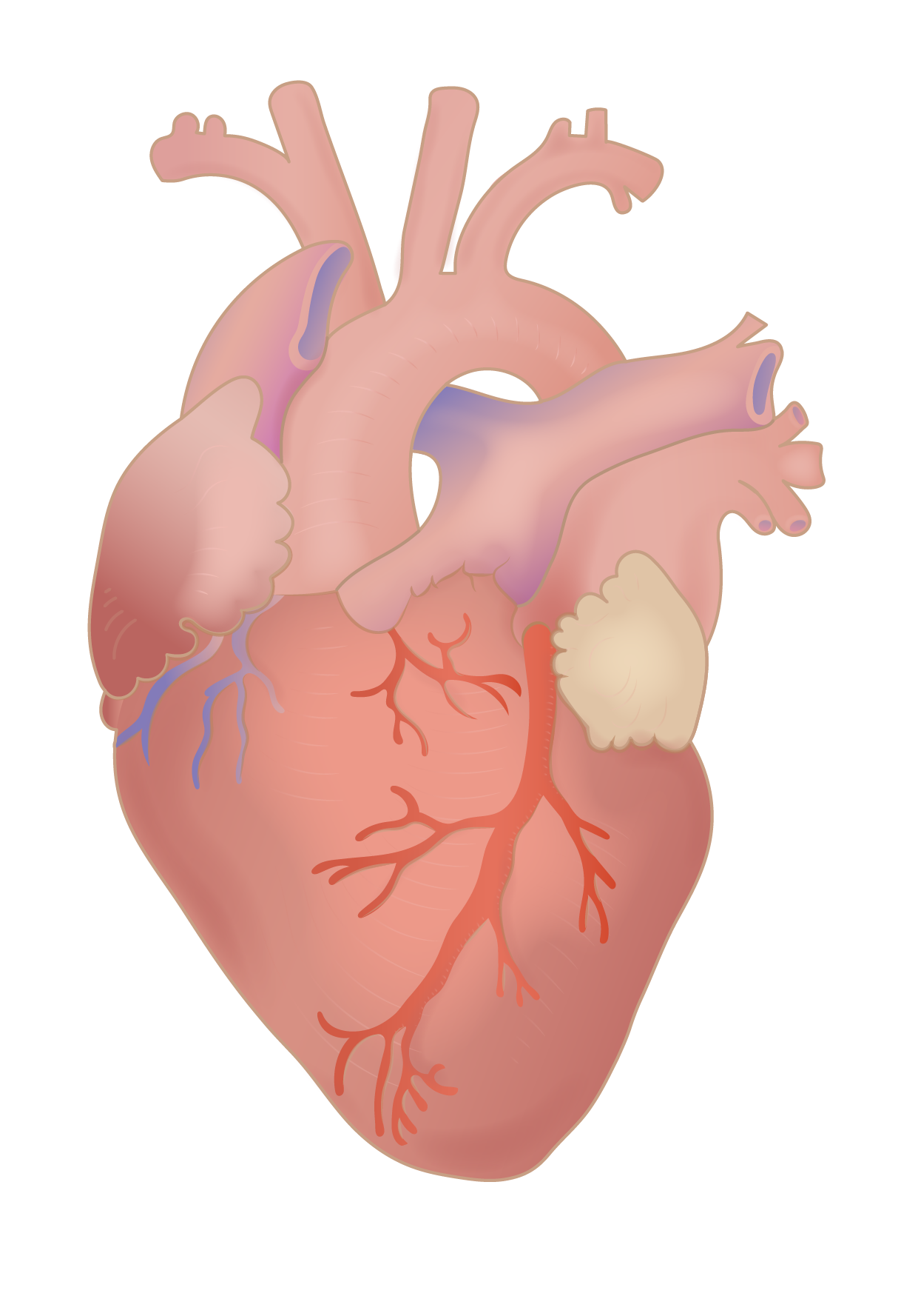


✓
Depression
Resting
Heart Rate
?
✓
Smoking
Notes:
Okay great, but our original question was: is the observed association between heart rate and depression completely explained by smoking?
We haven’t answered that yet.

Slide 10
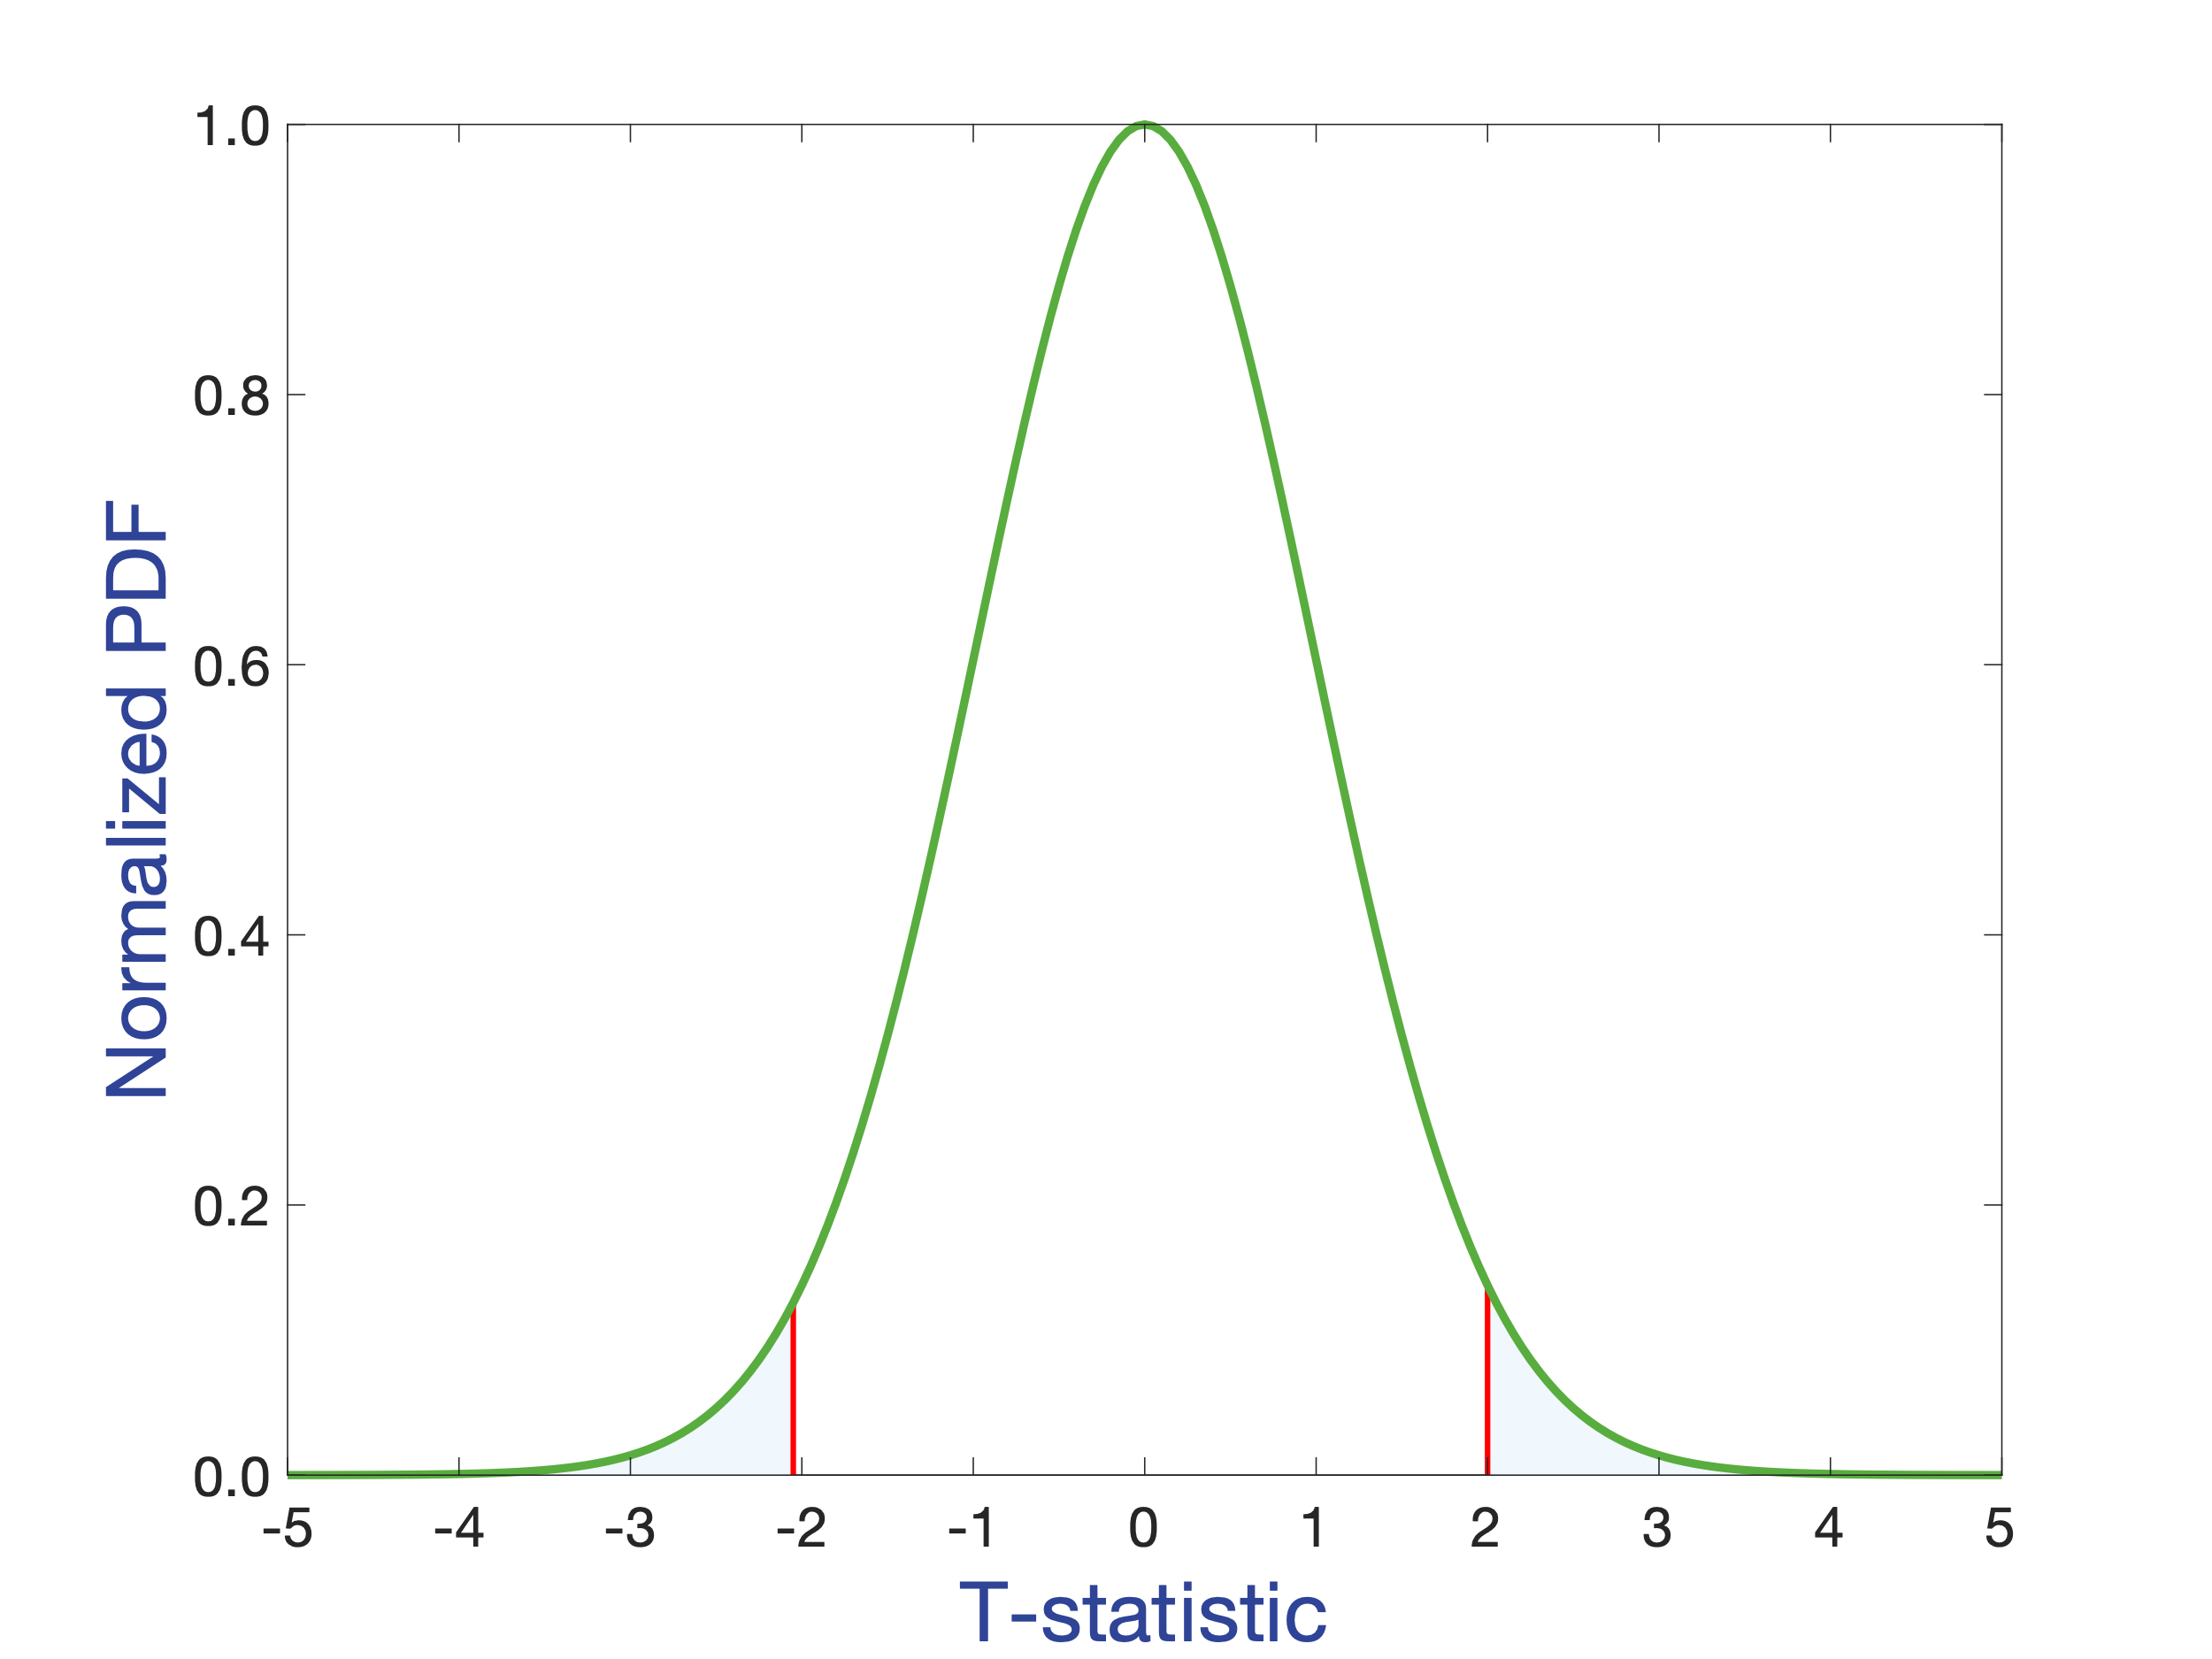
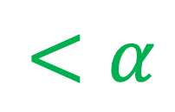
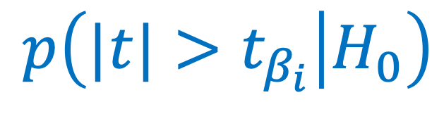
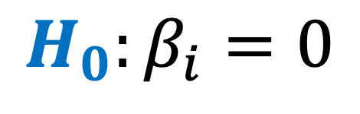
Inference on predictor variables
$$H_{0}:β_{i}=0$$
$$p\left(|t|>t_{β_{i}} | H_{0}\right)$$
$$<α$$
Notes:
One way to approach this question is to perform statistical analyses on each variable separately. Once we know our model is significant, we can proceed to look at the individual predictor variables.
The null hypothesis for a predictor variable is that its beta value is zero in the population, indicating no relationship.
We can convert our betas into t-statistics, which is another form of sampling distribution that looks like this. Note that it has two blue areas, and is called “two-tailed”. This just means it gets less likely to find very high positive or negative betas, under the null hypothesis.
As for our F-ratio test, we have a p value that looks like this: meaning the probability that t from a random sample would produce beta coefficients with magnitudes as high as the one we observed.
If this p-value is less than our threshold alpha, we can reject the null hypothesis for this variable!

Slide 11
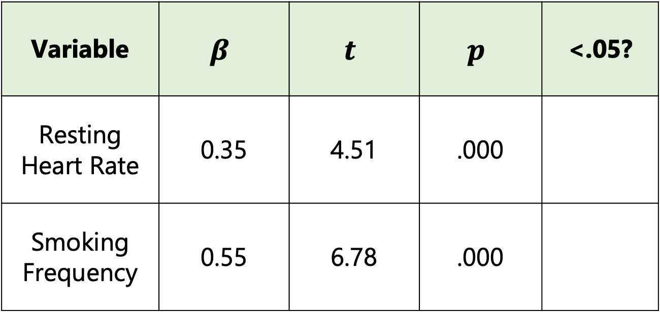
More results!
Variable | $$β$$ | $$t$$ | $$p$$ | <.05?
Resting Heart Rate | 0.35 | 4.51 | .000
Smoking Frequency | 0.55 | 6.78 | .000
Notes:
Performing this inference on all predictor variables gives us another table that looks like this. Here, we find that both resting heart rate and smoking have beta coefficients that are highly improbable under the null hypothesis. In other words, they are both significant.
This answers our question: smoking frequency does NOT explain the relationship between resting heart rate and depression. We’ve effectively removed it as a confound!

Slide 12
Coming up...
Different approaches to multiple linear regression
Notes:
This video explained the basics of the F-ratio test of the null hypothesis for a full model, and t-tests for individual predictor variables.
We will next learn about two major approaches to MLR: simultaneous and hierarchical.

